Slide 1


HIGH GAIN EXTENDED BOOST CONVERTER
Supervisor:
Eric Herbelin
Students:
Mohammad Suleiman
Salah Suleiman

Slide 2

Content:
introduction
analyzing theoretical side of the Project
circuit architecture and operation
simulations and results
problem discussions and ways to solve it
circuit optimization
Orcad capture implementation & PCB design
conclusions

Slide 3

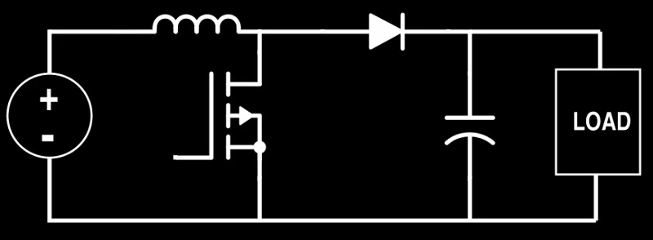
INTRODUCTION
We need to delve into the intricacies of a fundamental component in modern power electronics-the Boost Converter. As we navigate through the landscape of energy conversion, this compact yet indispensable device takes center stage, demonstrating its prowess in elevating voltage levels with precision and efficiency.
basic boost converter:

Slide 4
INTRODUCTION
We need to delve into the intricacies of a fundamental component in modern power electronics-the Boost Converter. As we navigate through the landscape of energy conversion, this compact yet indispensable device takes center stage, demonstrating its prowess in elevating voltage levels with precision and efficiency.
In an era where energy optimization is paramount, the Boost Converter emerges as a linchpin, facilitating the seamless integration of various power sources and driving innovation across industries.
basic boost converter:

Slide 5

Commencing the first stage of the Project
We will venture into the realm of Boost Converters, not merely to understand, but to elevate. Our focus shifts to an enhanced iteration: an augmented Boost Converter designed for unparalleled efficiency and voltage gain.

Slide 6
Commencing the first stage of the Project
We will venture into the realm of Boost Converters, not merely to understand, but to elevate. Our focus shifts to an enhanced iteration: an augmented Boost Converter designed for unparalleled efficiency and voltage gain.
In our exploration, we will unravel the intricacies of this advanced design, marked by carefully integrated components and layers. From refined inductors to sophisticated control mechanisms, each element contributes to a quantum leap in both efficiency and voltage elevation.

Slide 7
Commencing the first stage of the Project
We will venture into the realm of Boost Converters, not merely to understand, but to elevate. Our focus shifts to an enhanced iteration: an augmented Boost Converter designed for unparalleled efficiency and voltage gain.
In our exploration, we will unravel the intricacies of this advanced design, marked by carefully integrated components and layers. From refined inductors to sophisticated control mechanisms, each element contributes to a quantum leap in both efficiency and voltage elevation.
This presentation is not just about theory; it's a journey through empirical evidence and strategic engineering choices. Join us as we navigate through this evolution, unlocking the transformative potential that this enhanced Boost Converter holds for diverse applications in power electronics.

Slide 8
Commencing the first stage of the Project
We will venture into the realm of Boost Converters, not merely to understand, but to elevate. Our focus shifts to an enhanced iteration: an augmented Boost Converter designed for unparalleled efficiency and voltage gain.
In our exploration, we will unravel the intricacies of this advanced design, marked by carefully integrated components and layers. From refined inductors to sophisticated control mechanisms, each element contributes to a quantum leap in both efficiency and voltage elevation.
This presentation is not just about theory; it's a journey through empirical evidence and strategic engineering choices. Join us as we navigate through this evolution, unlocking the transformative potential that this enhanced Boost Converter holds for diverse applications in power electronics.
Together, let's delve into a heightened frontier of power conversion technology, a testament to our commitment to efficiency, innovation, and excellence in Boost Converter design.

Slide 9
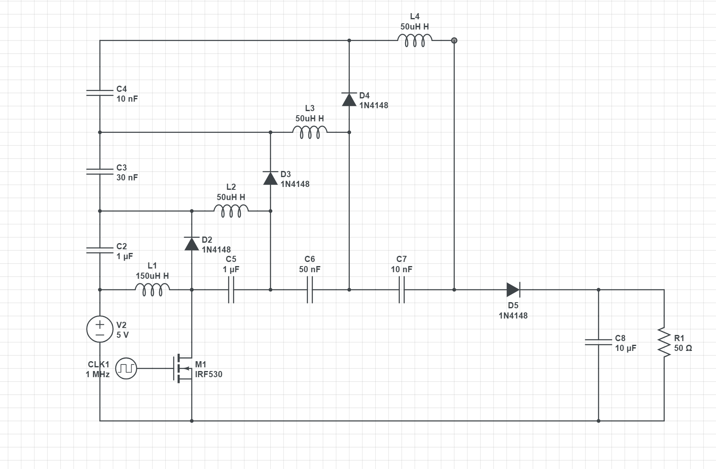
the schematic of our circuit design

Slide 10
Project Specifications
Clock/Switching Frequency: 1 MHz
Semiconductor Technology: Gallium Nitride (GaN) Transistors
Efficiency Rating Target: 85%
Physical Size: ≤ 4.0x4.0 sq inches
Simulation Accuracy: at least 90% between simulation and actual measurements.
Additional Note: using charge pump circuit to enhance accuracy can be a good solution. (we are working on this project).

Slide 11
Describe the circuit’s architecture and operation-first stage
To confirm Continuous Conduction Mode (CCM) in the circuit, simulate inductor current, verify waveform positivity, compute average current, and ensure a consistently positive difference between inductor current and ripple amplitude.
This approach, combining simulation and analysis, rigorously establishes operational conformity in CCM.

Slide 12
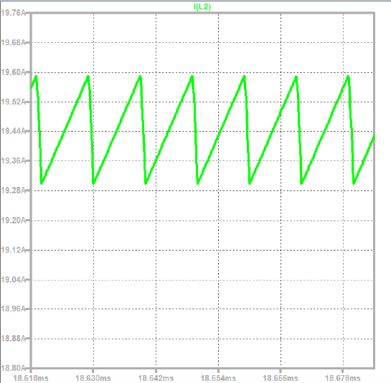
Simulations that describe the current during the inductor
Like we see in this simulation, the current is positive and cyclic, and this approving to use the equations in CCM mode.

Slide 13
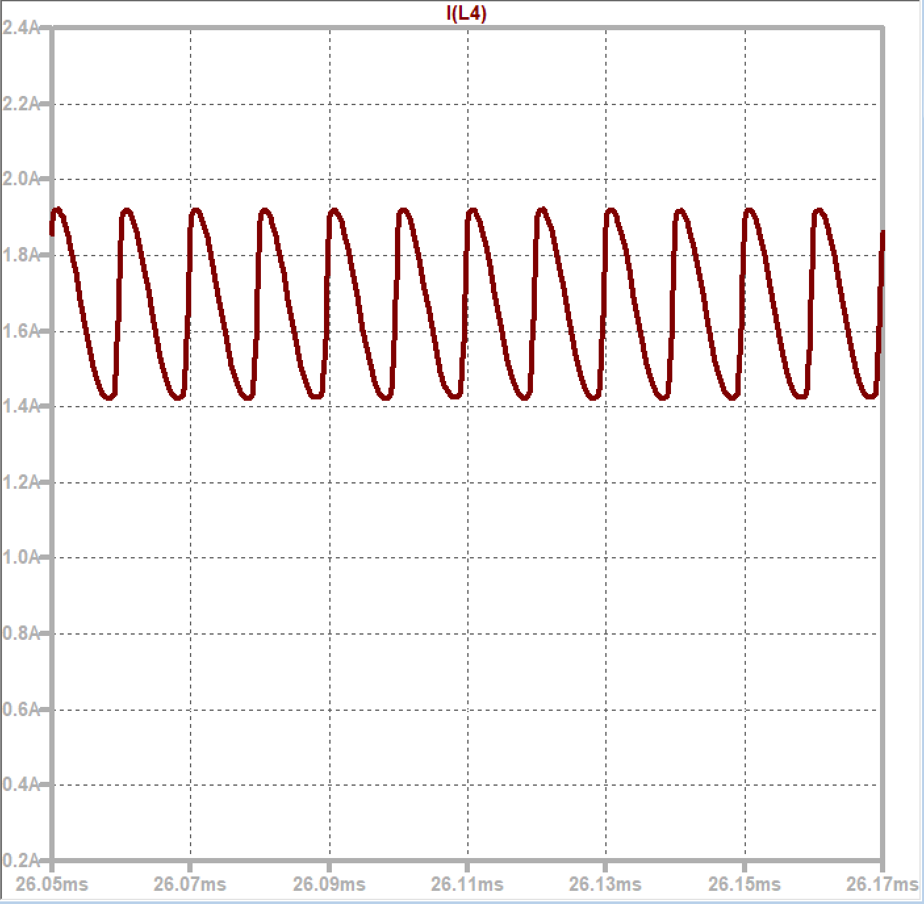
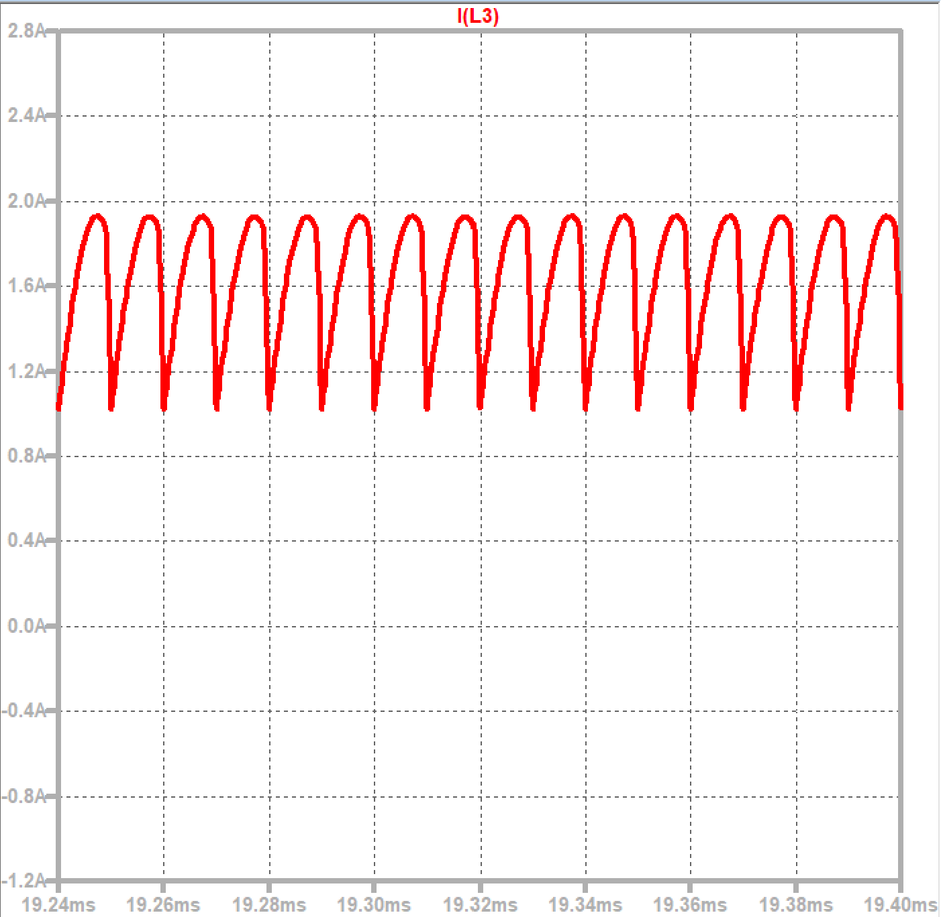
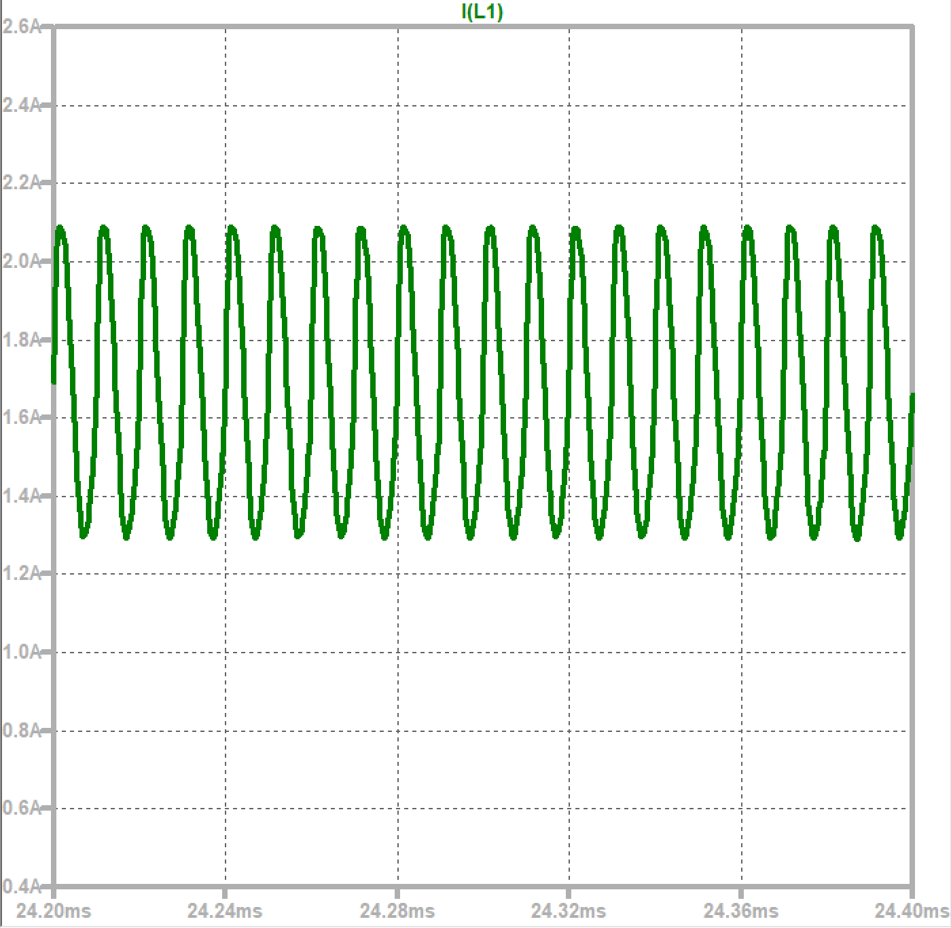
Current During Inductors

Slide 14
Special characteristics of the circuit
The given converter consists of a basic boost converter with additional layers. Each loop includes a diode, storage capacitors, a vertical capacitor, and an inductor. We’ll analyze its functionality, starting with a two-layer basic boost converter and then extending to n layers. Our extended boost converter adds three extra layers.

Slide 15
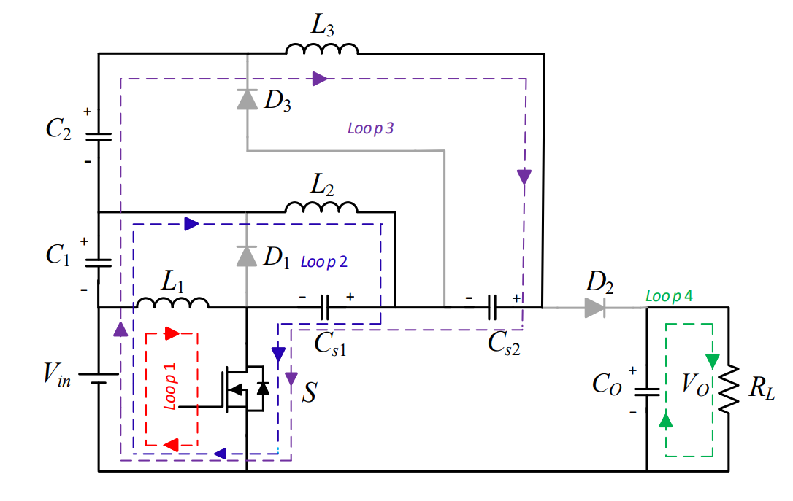
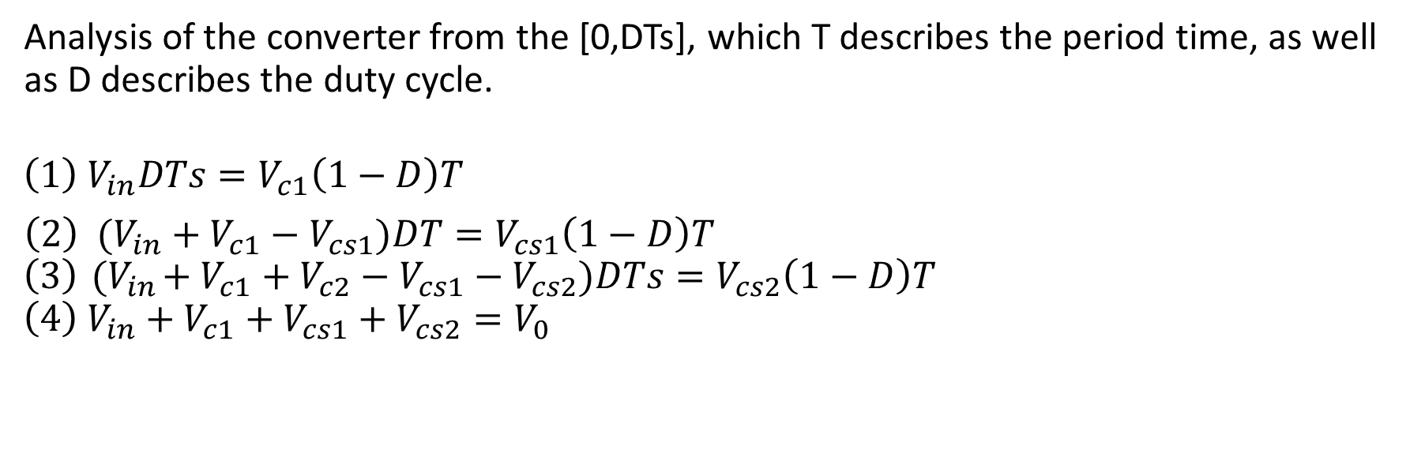
CCM equations and operations
Analysis of the converter from the [0,DTs], which T describes the period time, as well as D describes the duty cycle.
$$\left(1\right) V_{in}DTs=V_{c1}\left(1−D\right)T$$
${\left(2\right) (V}_{in}+V_{c1}−V_{cs1})DT=V_{cs1}\left(1−D\right)T$
$$\left(3\right){ (V}_{in}+V_{c1}+V_{c2}−V_{cs1}−V_{cs2})DTs=V_{cs2}\left(1−D\right)T$$
$${\left(4\right) V}_{in}+V_{c1}+V_{cs1}+V_{cs2}=V_{0}$$

Slide 16
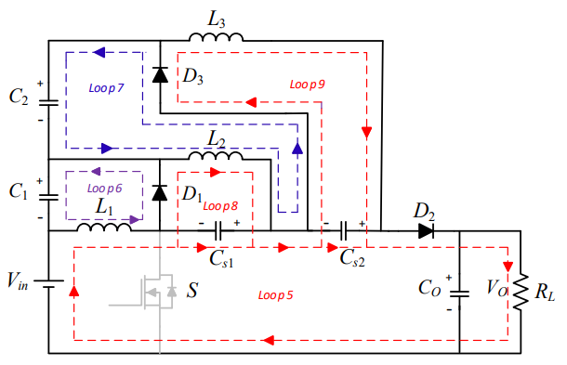
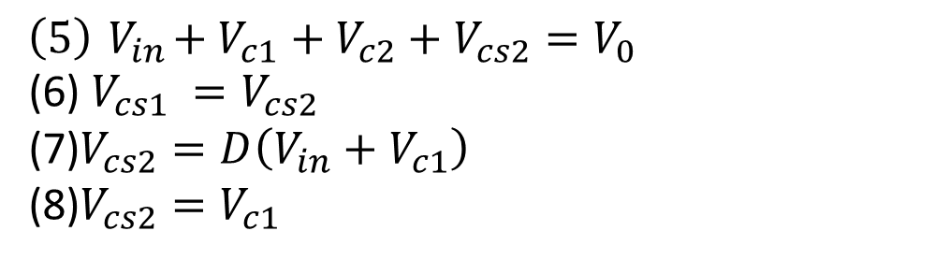
CCM equations and operations
Analysis of the converter from the [DTs, Ts], which T describes the period time, as well as D describes the duty cycle, note that 0<D<1.
$$\left(5\right){ V}_{in}+V_{c1}+V_{c2}+V_{cs2}=V_{0}$$
(6) $V_{cs1} =V_{cs2}$
(7)$V_{cs2}=D\left(V_{in}+V_{c1}\right)$
(8)$V_{cs2}=V_{c1}$

Slide 17
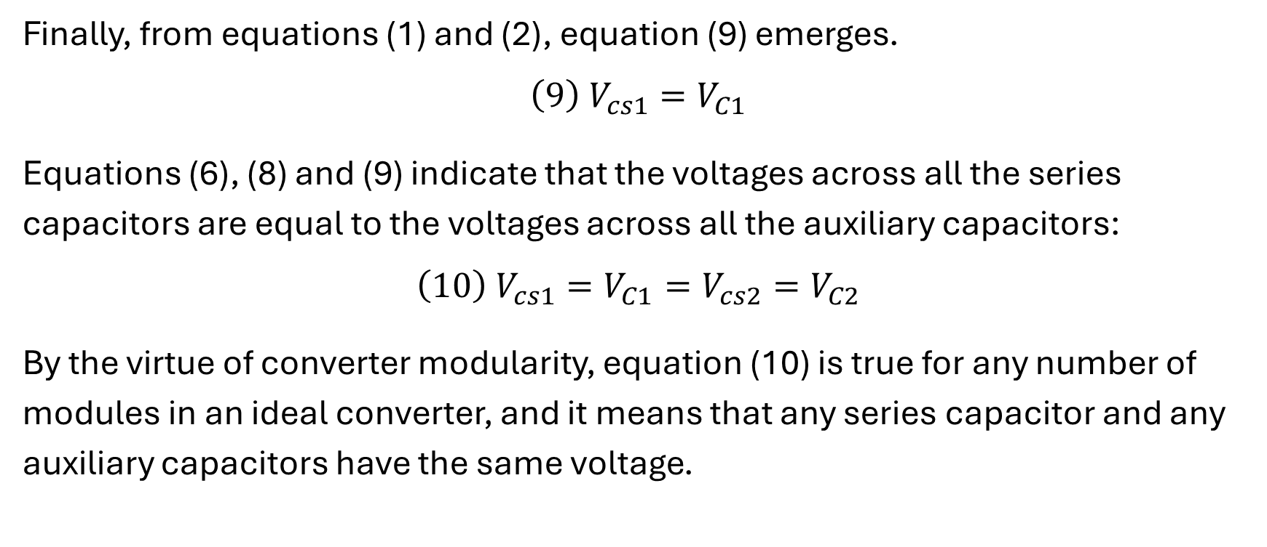
CCM equations and operations
Finally, from equations (1) and (2), equation (9) emerges.
$$\left(9\right) V_{cs1}=V_{C1}$$
Equations (6), (8) and (9) indicate that the voltages across all the series capacitors are equal to the voltages across all the auxiliary capacitors:
$$\left(10\right) V_{cs1}=V_{C1}=V_{cs2}=V_{C2}$$
By the virtue of converter modularity, equation (10) is true for any number of modules in an ideal converter, and it means that any series capacitor and any auxiliary capacitors have the same voltage.

Slide 18
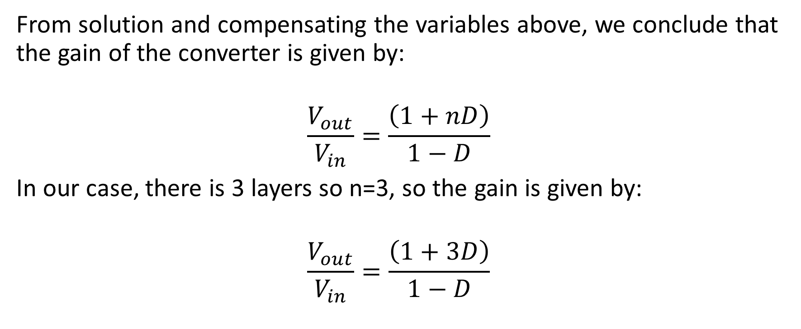
CCM equations and operation
From solution and compensating the variables above, we conclude that the gain of the converter is given by:
$$\frac{V_{out}}{V_{in}}=\frac{\left(1+nD\right)}{1−D}$$
In our case, there is 3 layers so n=3, so the gain is given by:
$$\frac{V_{out}}{V_{in}}=\frac{\left(1+3D\right)}{1−D}$$

Slide 19
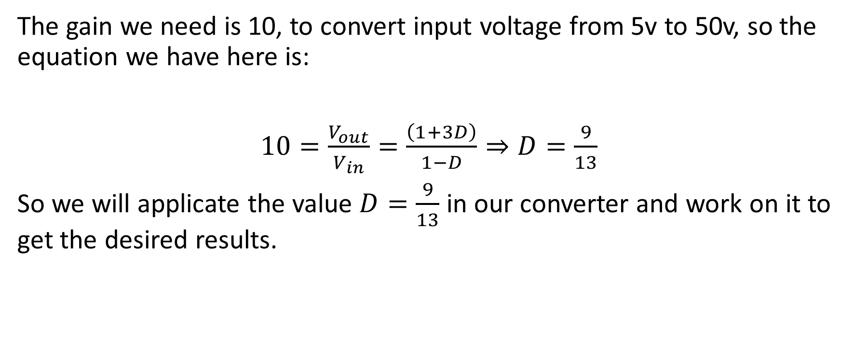
Theoretical Analysis of the circuit
The gain we need is 10, to convert input voltage from 5v to 50v, so the equation we have here is:
$10=\frac{V_{out}}{V_{in}}=\frac{\left(1+3D\right)}{1−D}⇒D=\frac{9}{13}$
So we will applicate the value $D=\frac{9}{13}$ in our converter and work on it to get the desired results.

Slide 20
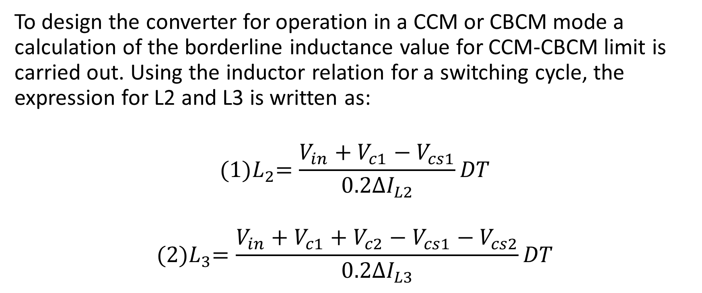
inductor
To design the converter for operation in a CCM or CBCM mode a calculation of the borderline inductance value for CCM-CBCM limit is carried out. Using the inductor relation for a switching cycle, the expression for L2 and L3 is written as:
$${(1)L}_{2}=\frac{V_{in}+V_{c1}−V_{cs1}}{0.2∆I_{L2}}DT$$
$${(2)L}_{3}=\frac{V_{in}+V_{c1}+V_{c2}−V_{cs1}−V_{cs2}}{0.2∆I_{L3}}DT$$

Slide 21
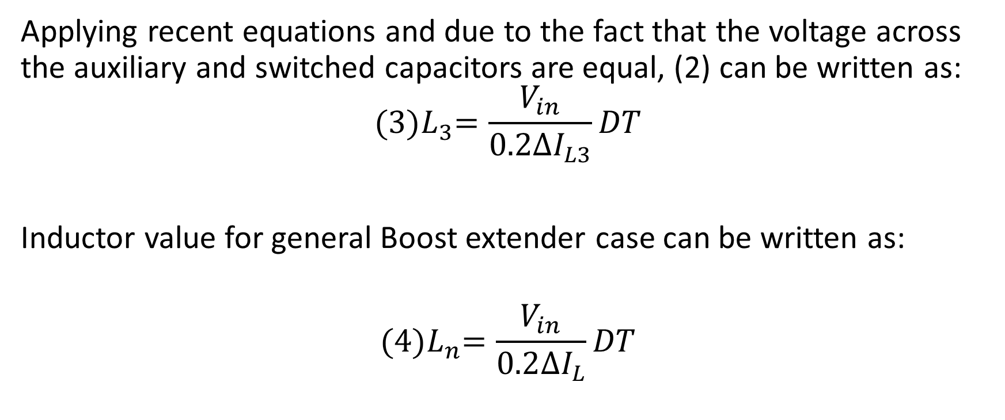
inductor
Applying recent equations and due to the fact that the voltage across the auxiliary and switched capacitors are equal, (2) can be written as:
$${(3)L}_{3}=\frac{V_{in}}{0.2∆I_{L3}}DT$$
Inductor value for general Boost extender case can be written as:
$${(4)L}_{n}=\frac{V_{in}}{0.2∆I_{L}}DT$$

Slide 22
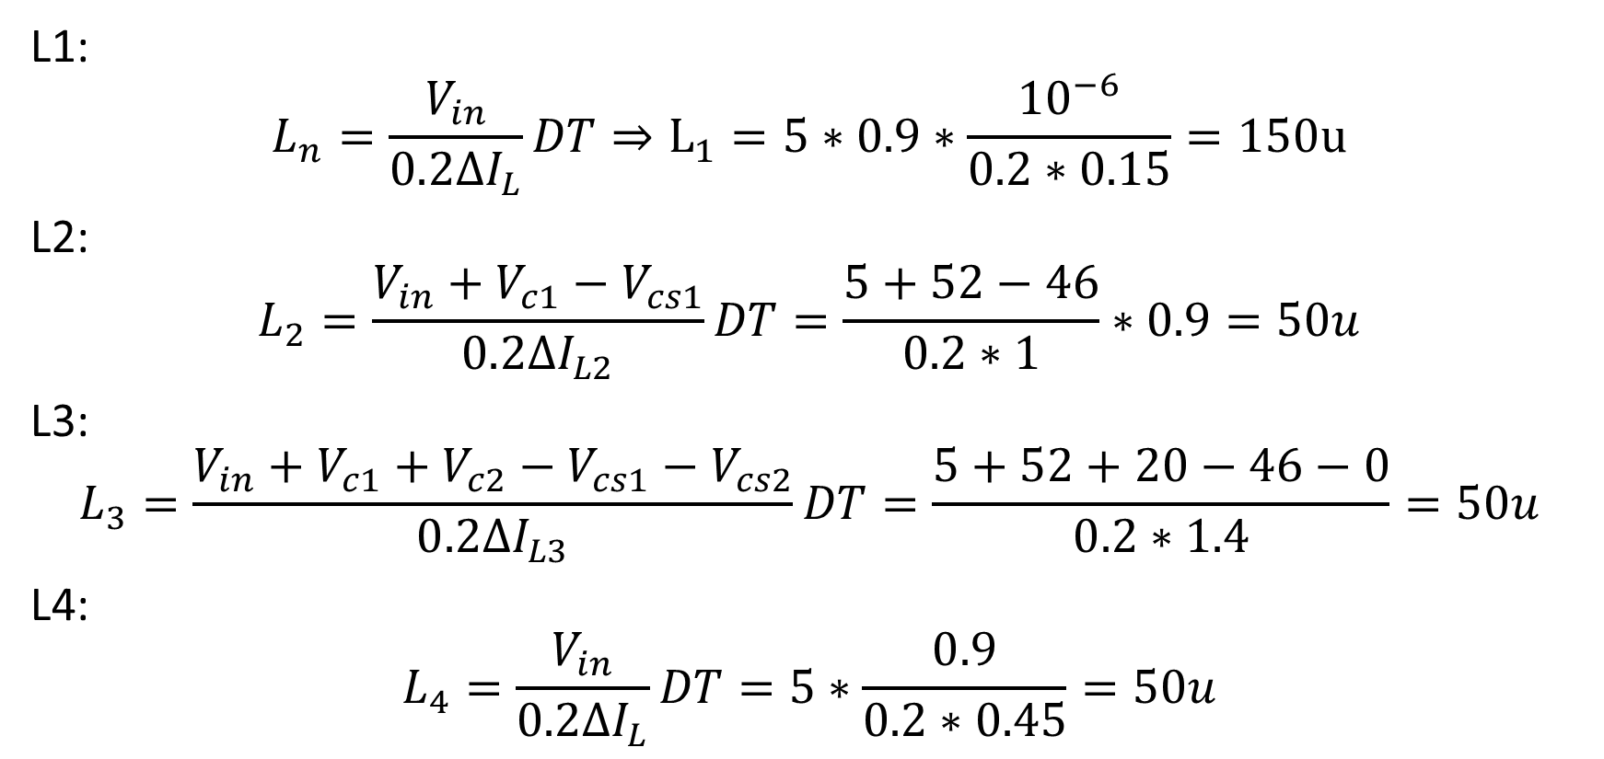
inductors
L1:
$$L_{n}=\frac{V_{in}}{0.2∆I_{L}}DT⇒L_{1}=5∗0.9∗\frac{{10}^{−6}}{0.2∗0.15}=150u$$
L2:
$$L_{2}=\frac{V_{in}+V_{c1}−V_{cs1}}{0.2∆I_{L2}}DT=\frac{5+52−46}{0.2∗1}∗0.9=50u$$
L3:
$$L_{3}=\frac{V_{in}+V_{c1}+V_{c2}−V_{cs1}−V_{cs2}}{0.2∆I_{L3}}DT=\frac{5+52+20−46−0}{0.2∗1.4}=50u$$
L4:
$$L_{4}=\frac{V_{in}}{0.2∆I_{L}}DT=5∗\frac{0.9}{0.2∗0.45}=50u$$

Slide 23
Considerations in choosing inductors
The choice of inductor current ripple for each stage involves a trade-off between various factors, as discussed earlier. Let's evaluate the implications of the specified ripple values:
0.15A:
This represents a very small inductor current ripple. It may lead to a more stable output voltage and reduced EMI, but it might result in larger inductor size and potentially higher costs.

Slide 24
Considerations in choosing inductors
1A:
A ripple of 1A is moderate and may provide a balance between efficiency, size, and cost. It's a common choice in many boost converter designs.
1.45A:
This represents a relatively higher inductor current ripple. While it may reduce inductor size and cost, it could lead to higher losses, reduced efficiency, and potentially higher EMI.

Slide 25
Considerations in choosing inductors
0.45A:
This is a moderately small ripple, offering a good balance. It may provide stability in the output voltage without significantly increasing the inductor size or cost.
Consider Size Constraints:
If space is limited, you might lean towards smaller ripple values to avoid larger inductors. However, keep in mind that smaller inductors might be more expensive.

Slide 26
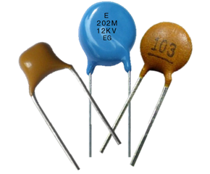
capacitors
The chosen capacitors are ceramic specifically X5R/X7R.
Here are some reasons why ceramic capacitors are commonly used in boost converters:
1. Low Equivalent Series Resistance.
2. High Switching Frequencies
3. Temperature Stability
4. RoHS Compliance
5. Wide Voltage Ratings

Slide 27
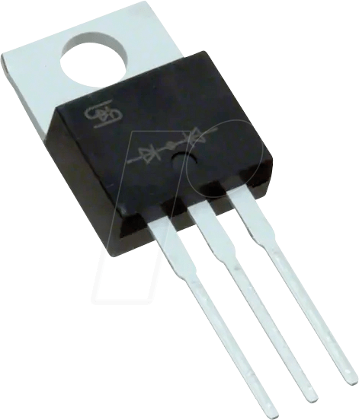
diodes
We chose Schottky diodes in our design.
Choosing Schottky diodes in boost converters offers several advantages:
1. Fast Switching Speed
2. Low Forward Voltage Drop
3. Reduced Reverse Recovery Time
4. Efficient at Low Voltage Drops
5. Compact Size
6. Temperature Stability

Slide 28
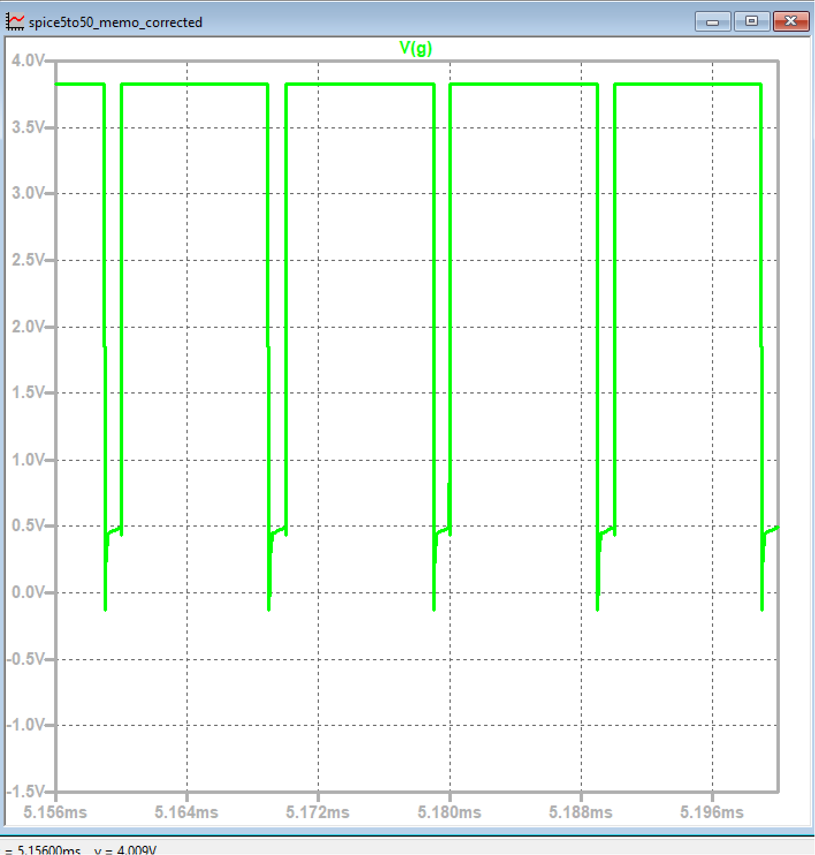
PWM

Slide 29
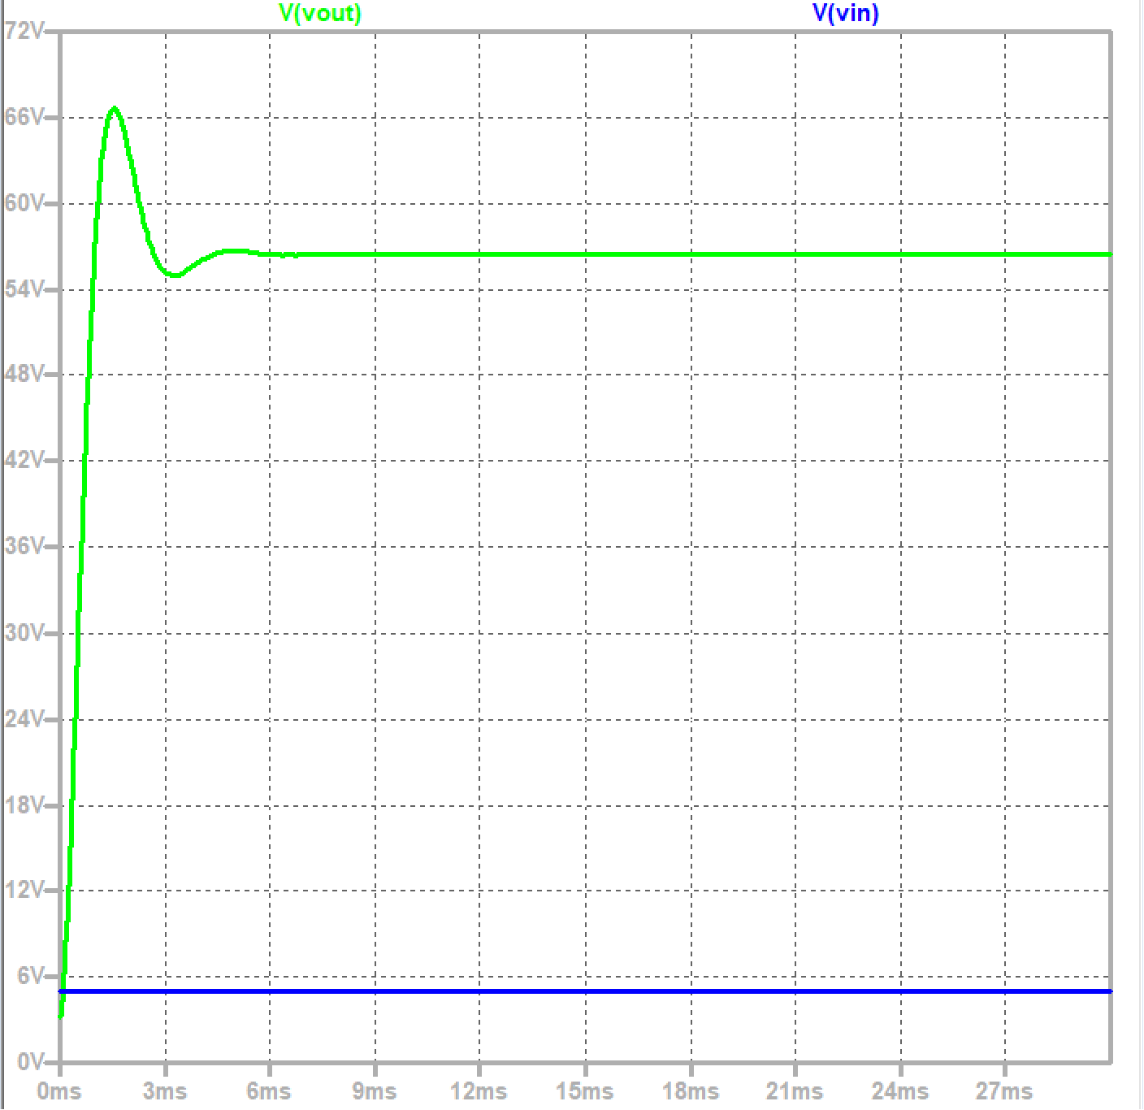
Vin-Vout analysis

Slide 30
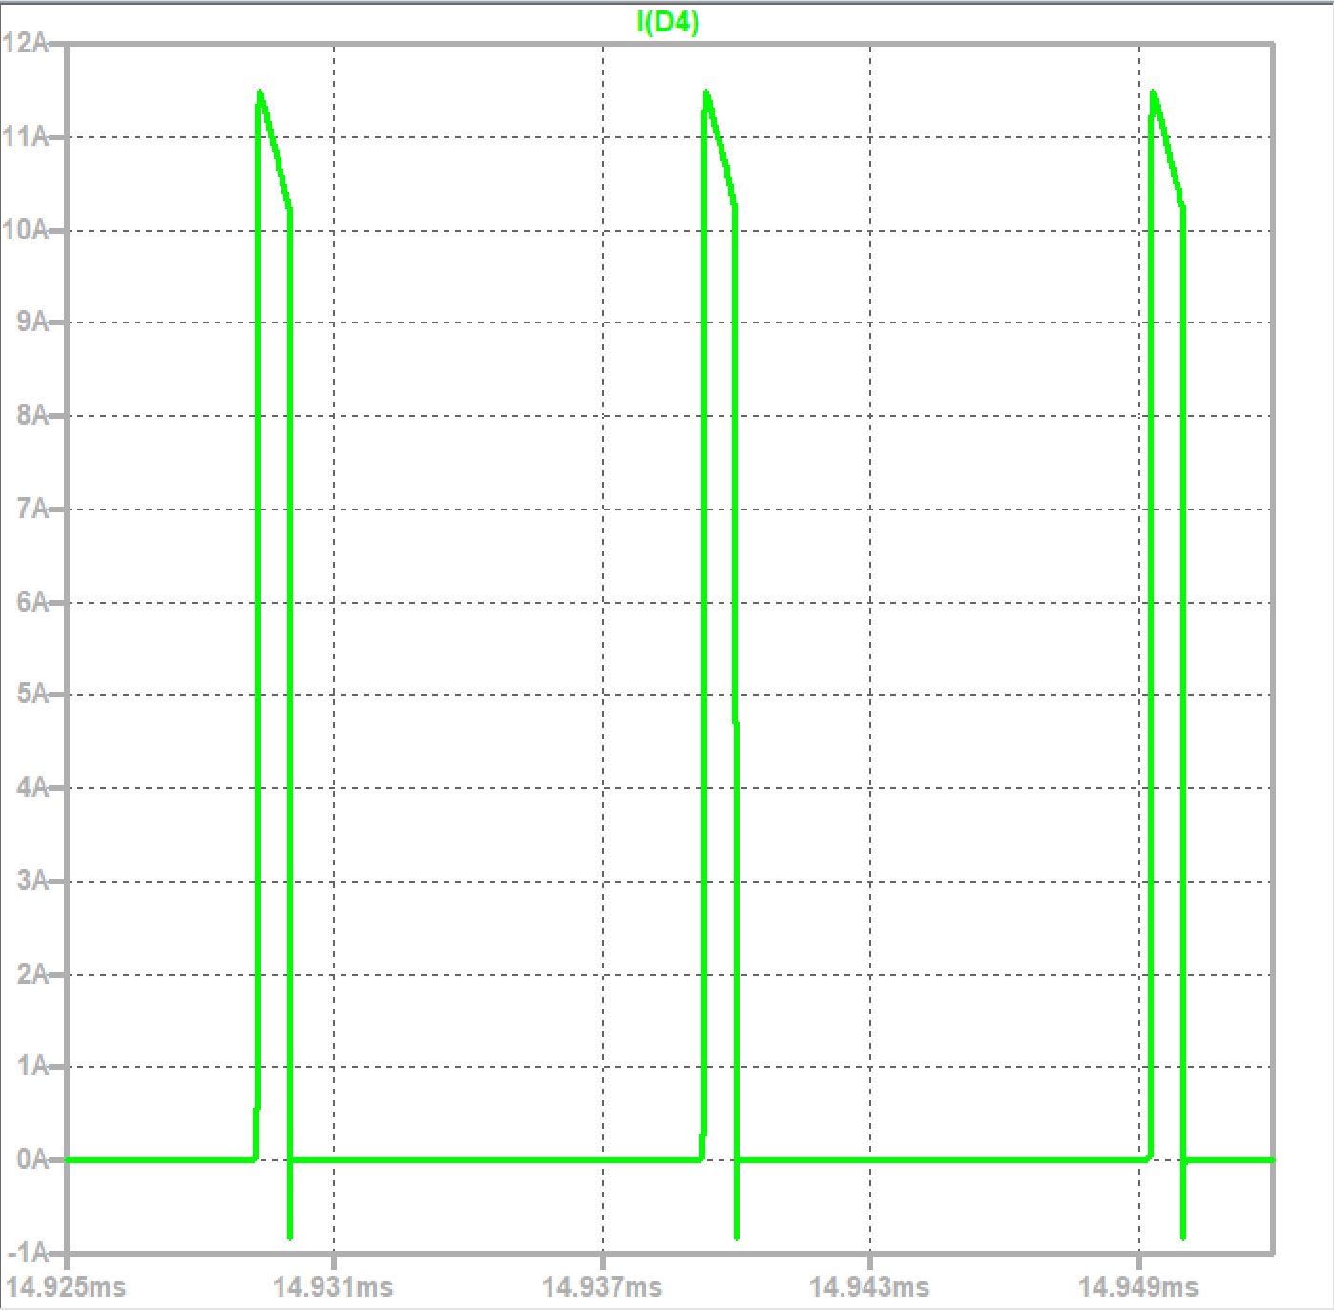
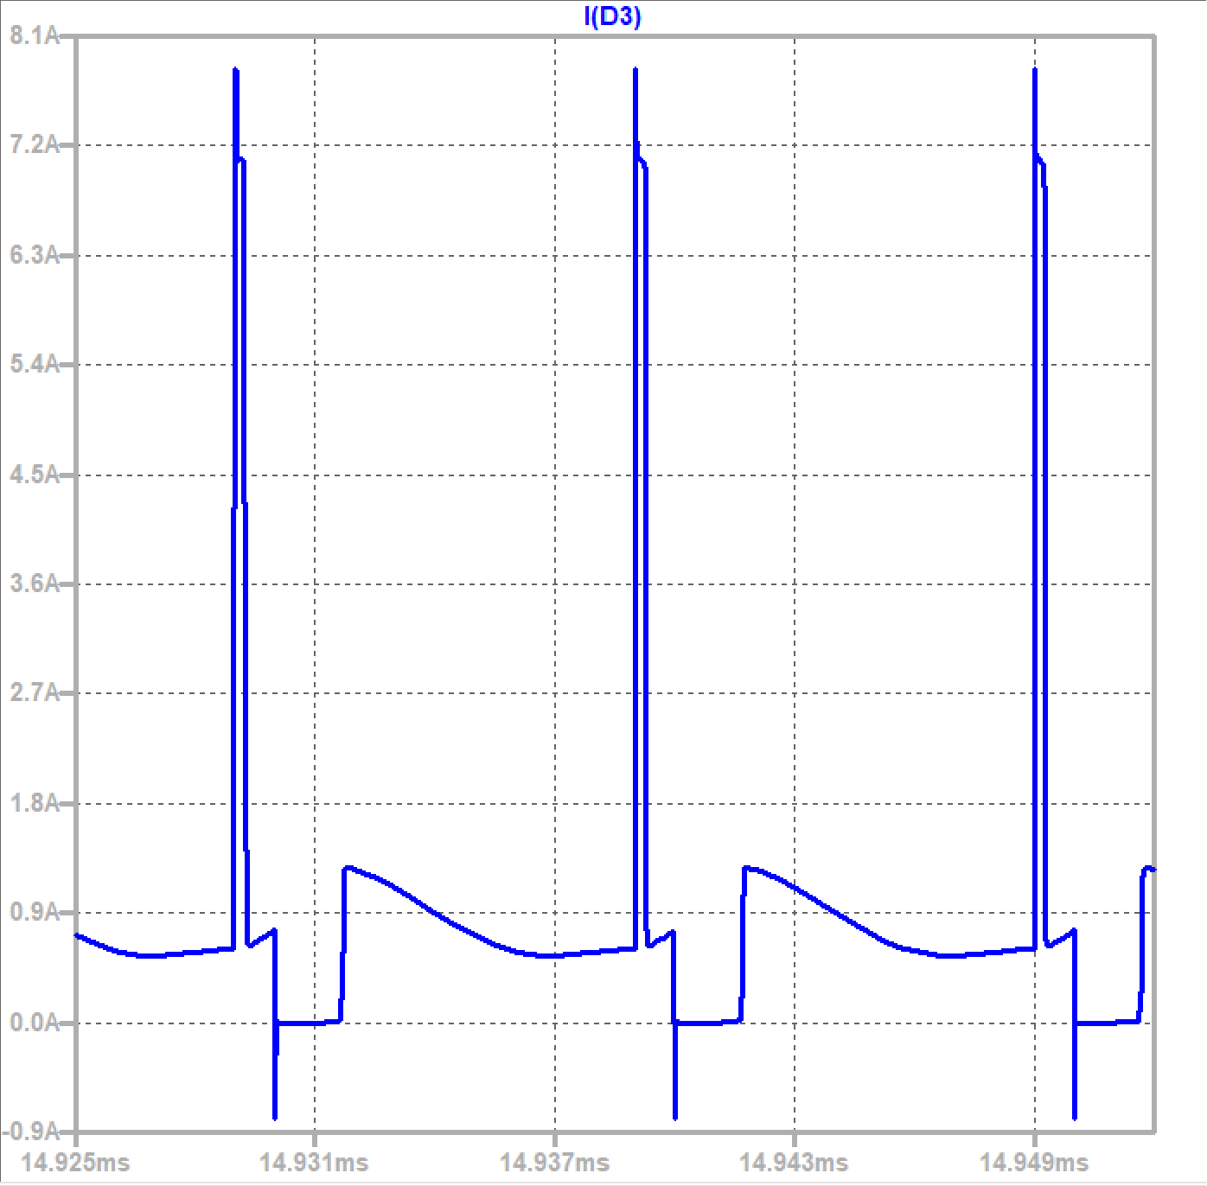
Diode analysis
This simulations describe the Current during the diodes:

Slide 31
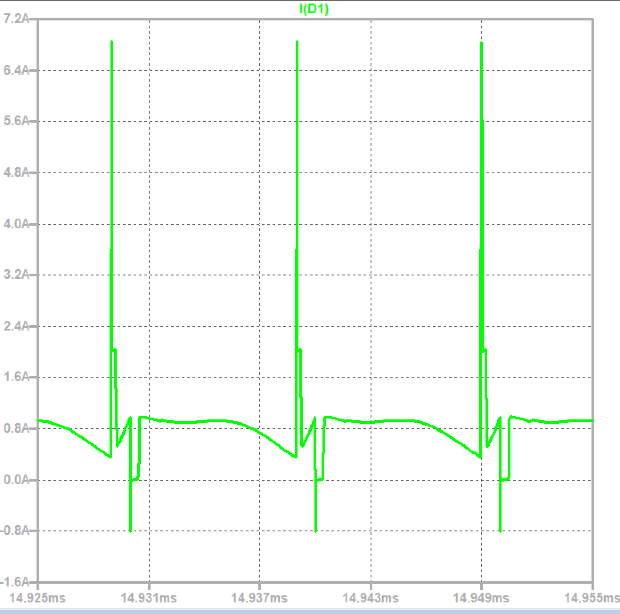
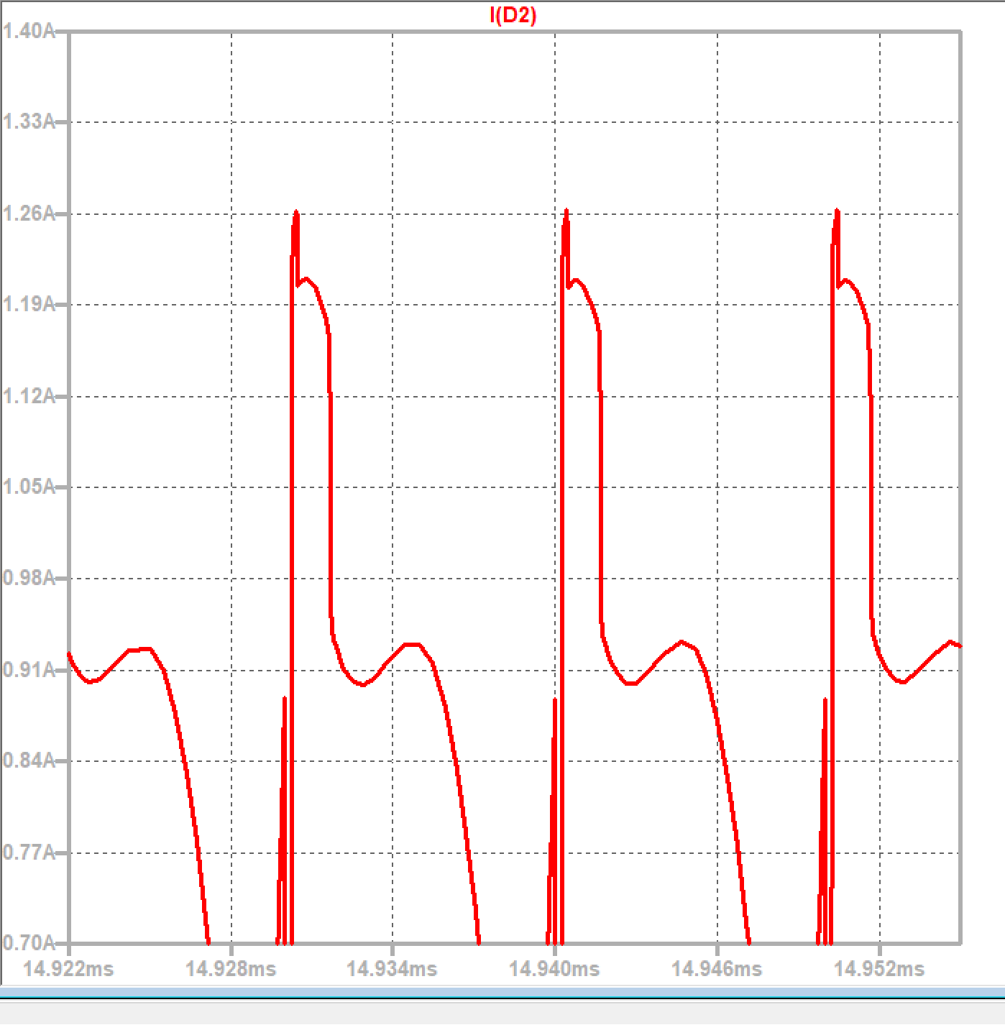
Diode analysis

Slide 32
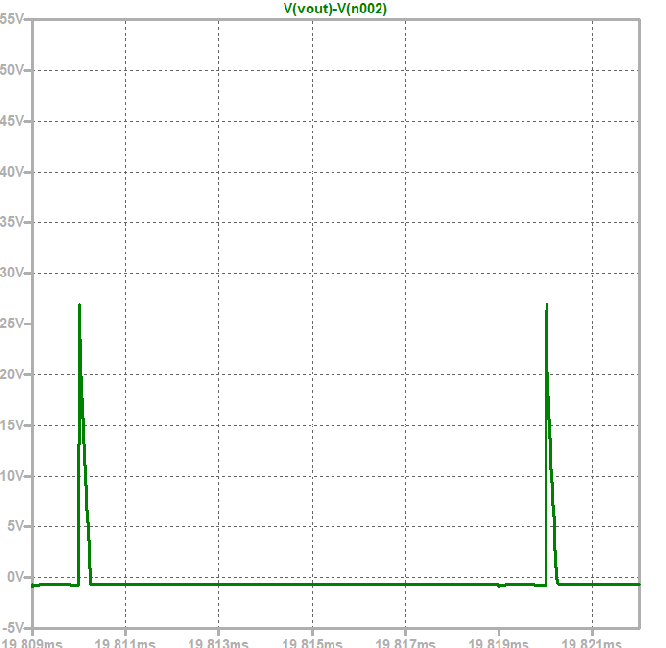
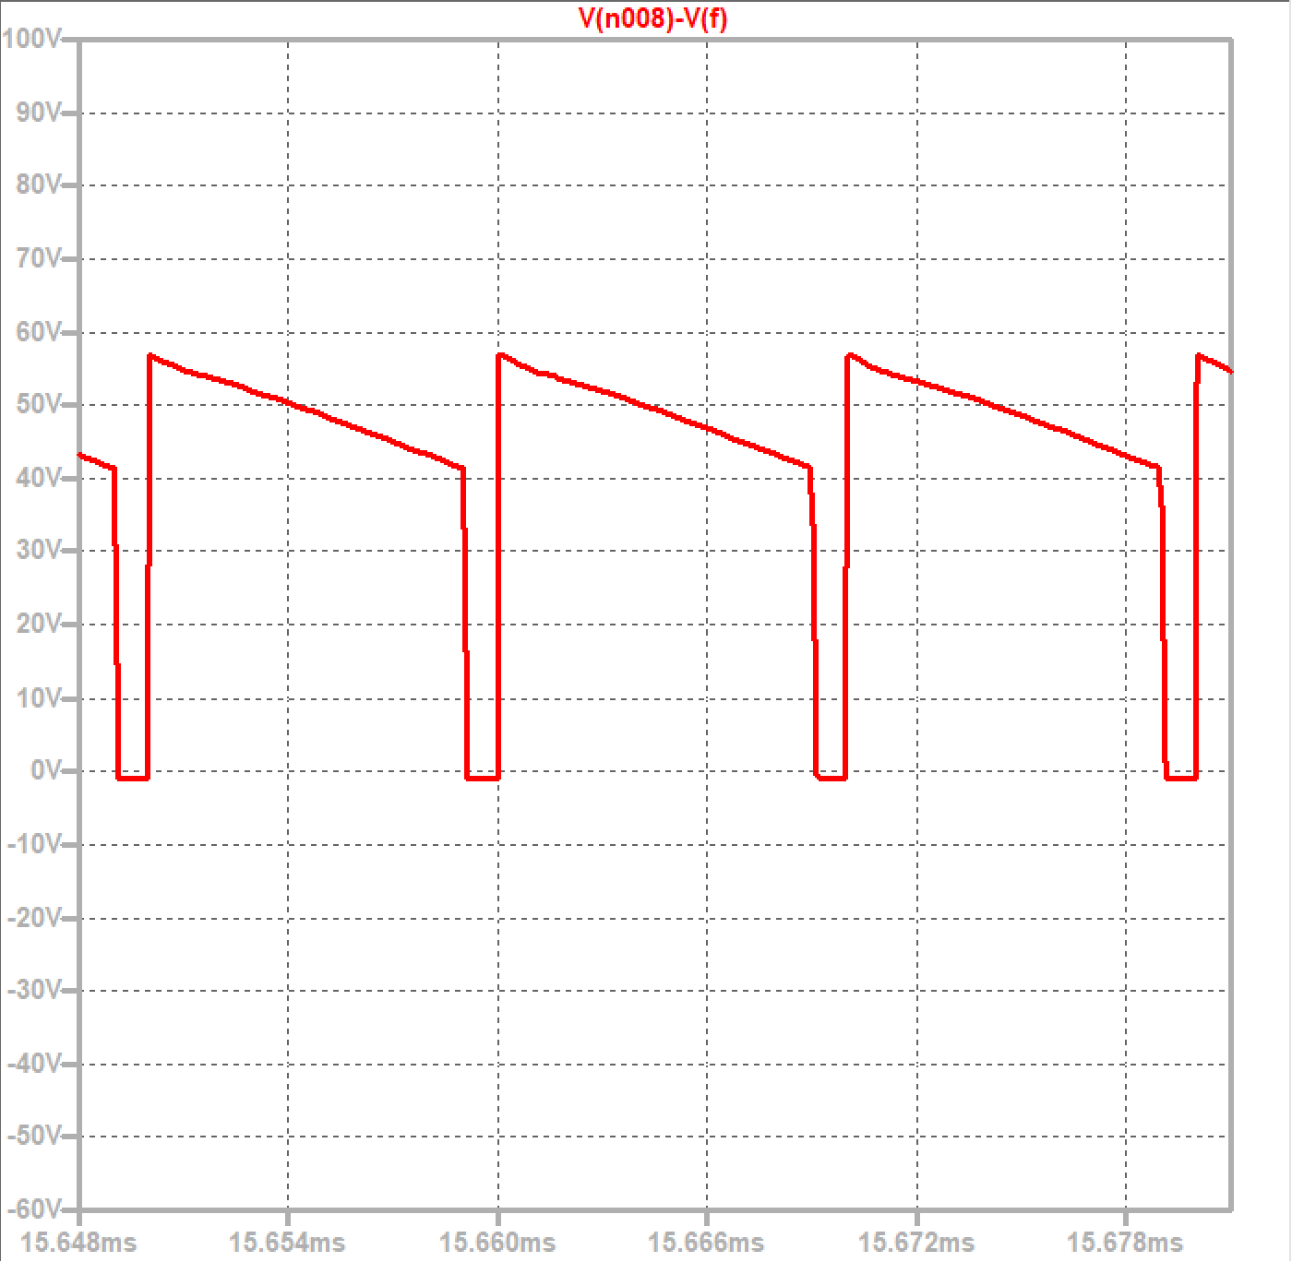
Voltage on the diodes

Slide 33
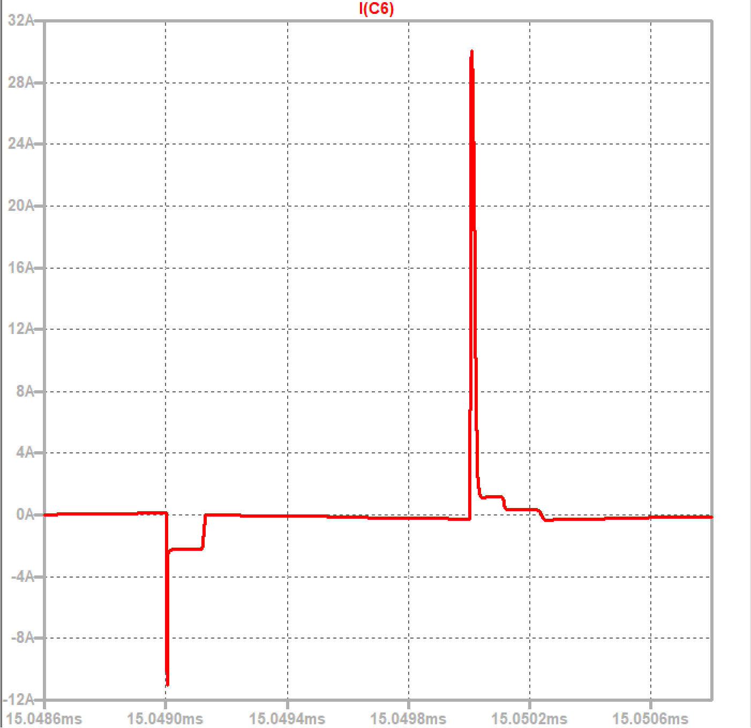
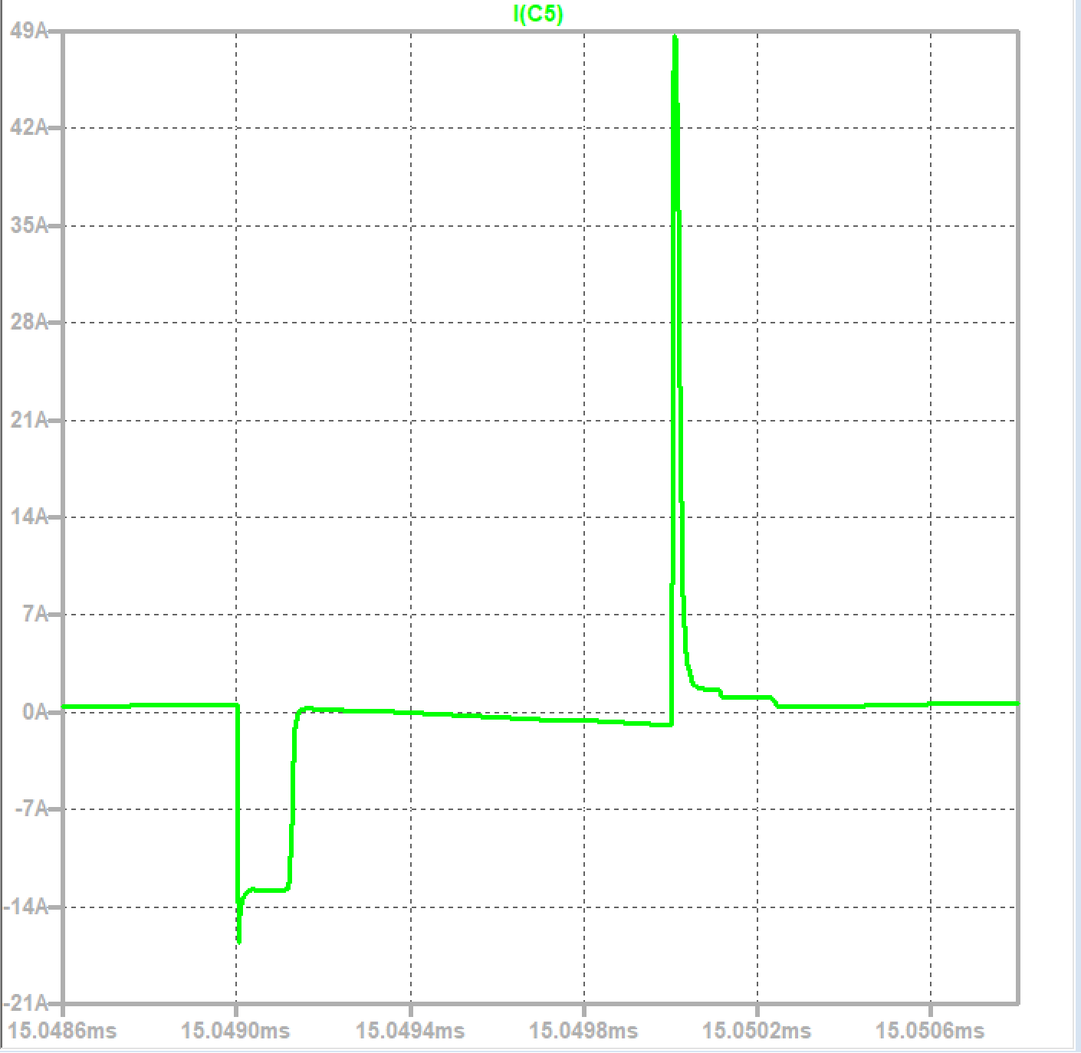
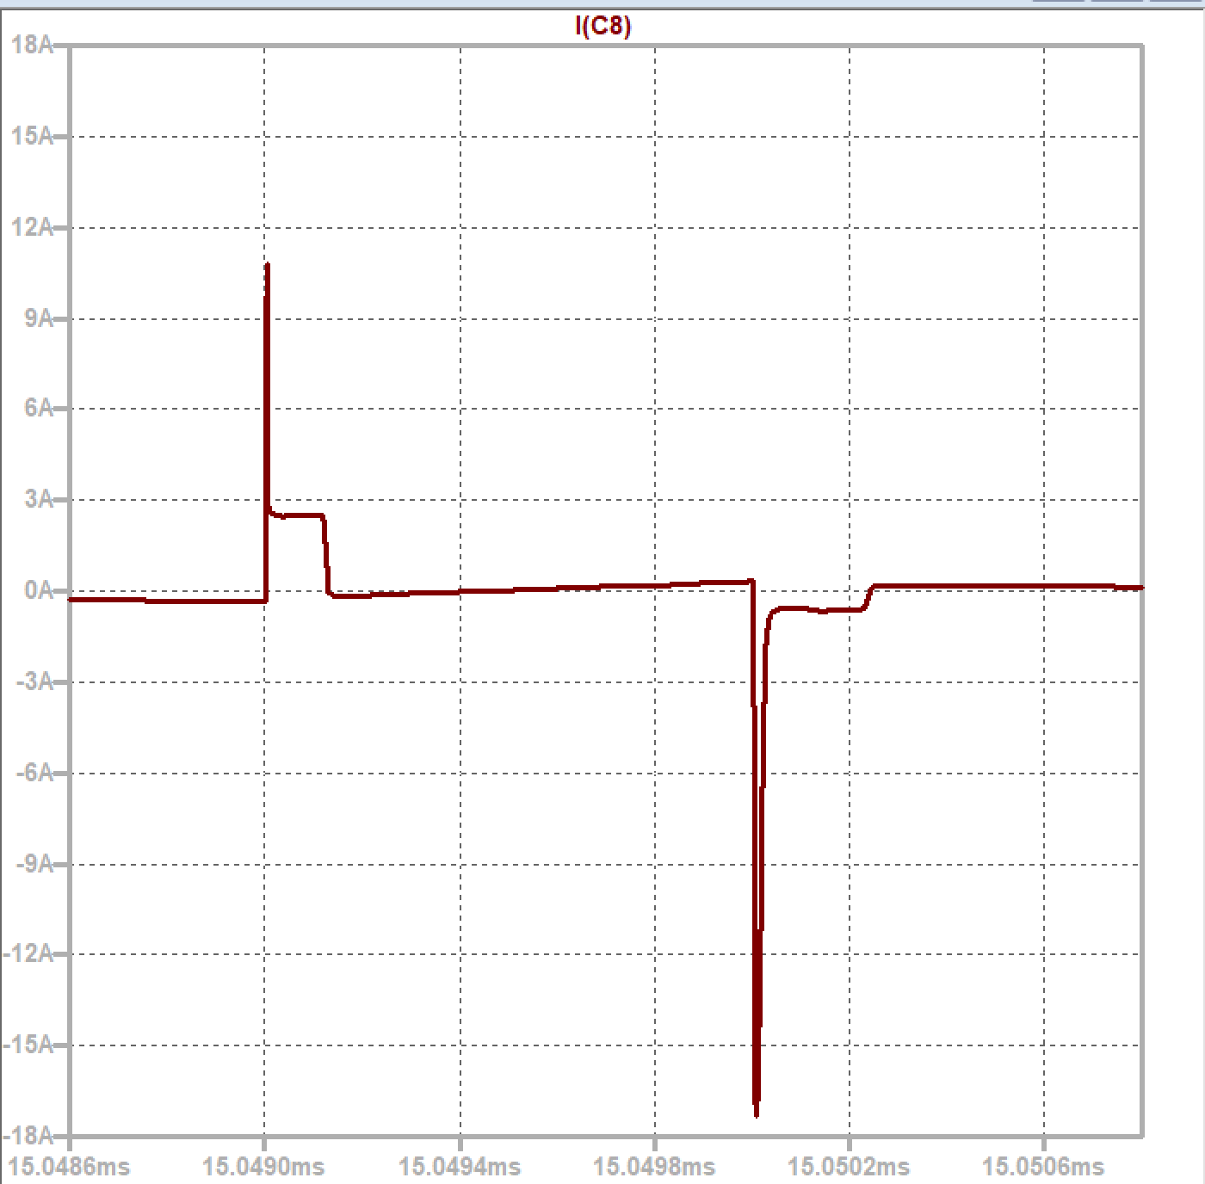
Capacitor Current Waveforms
Stuck capacitors current+output:

Slide 34
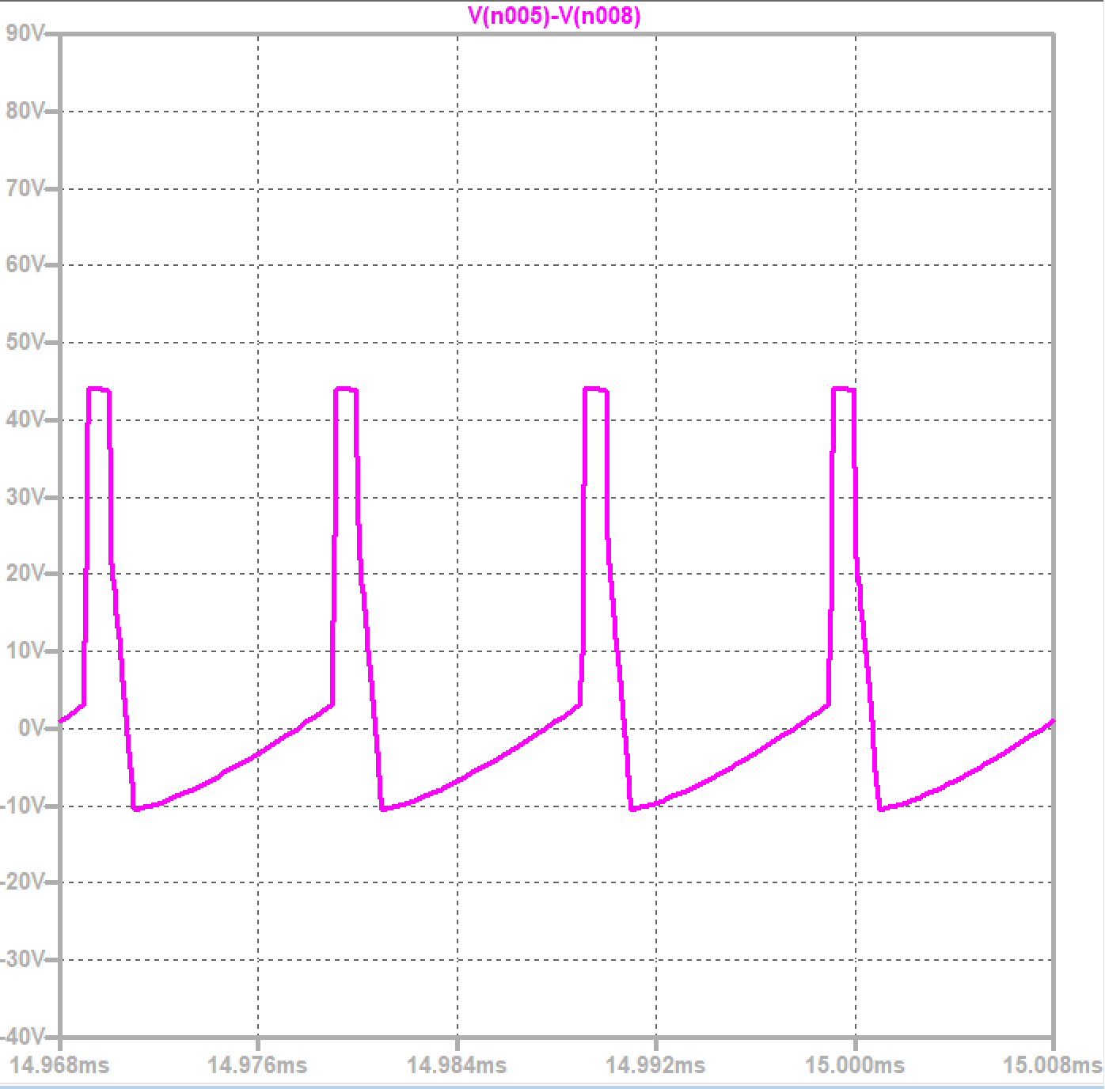
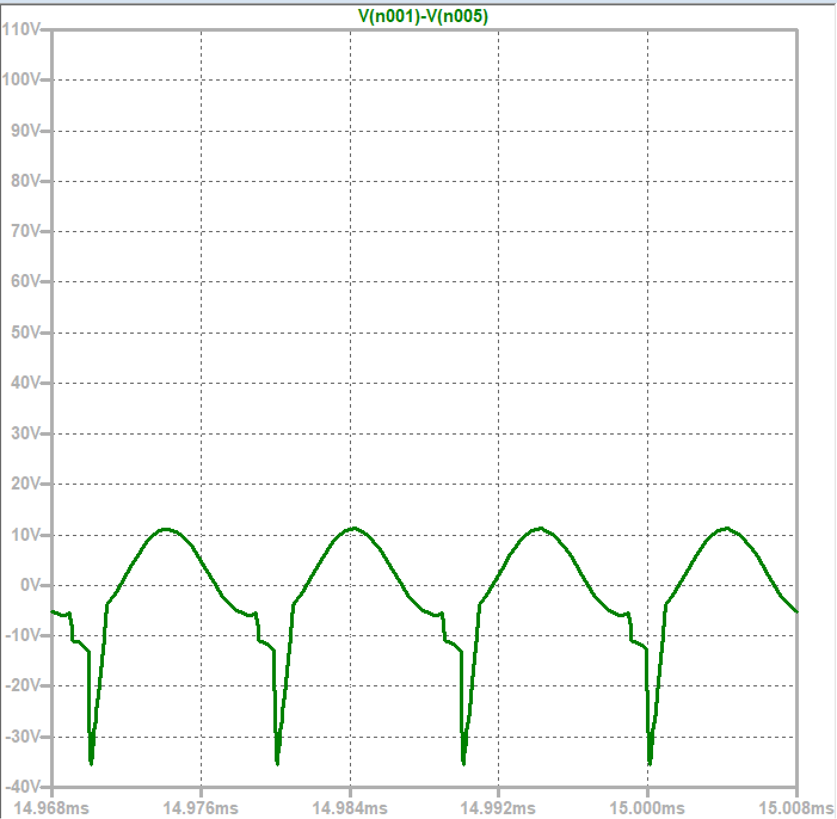
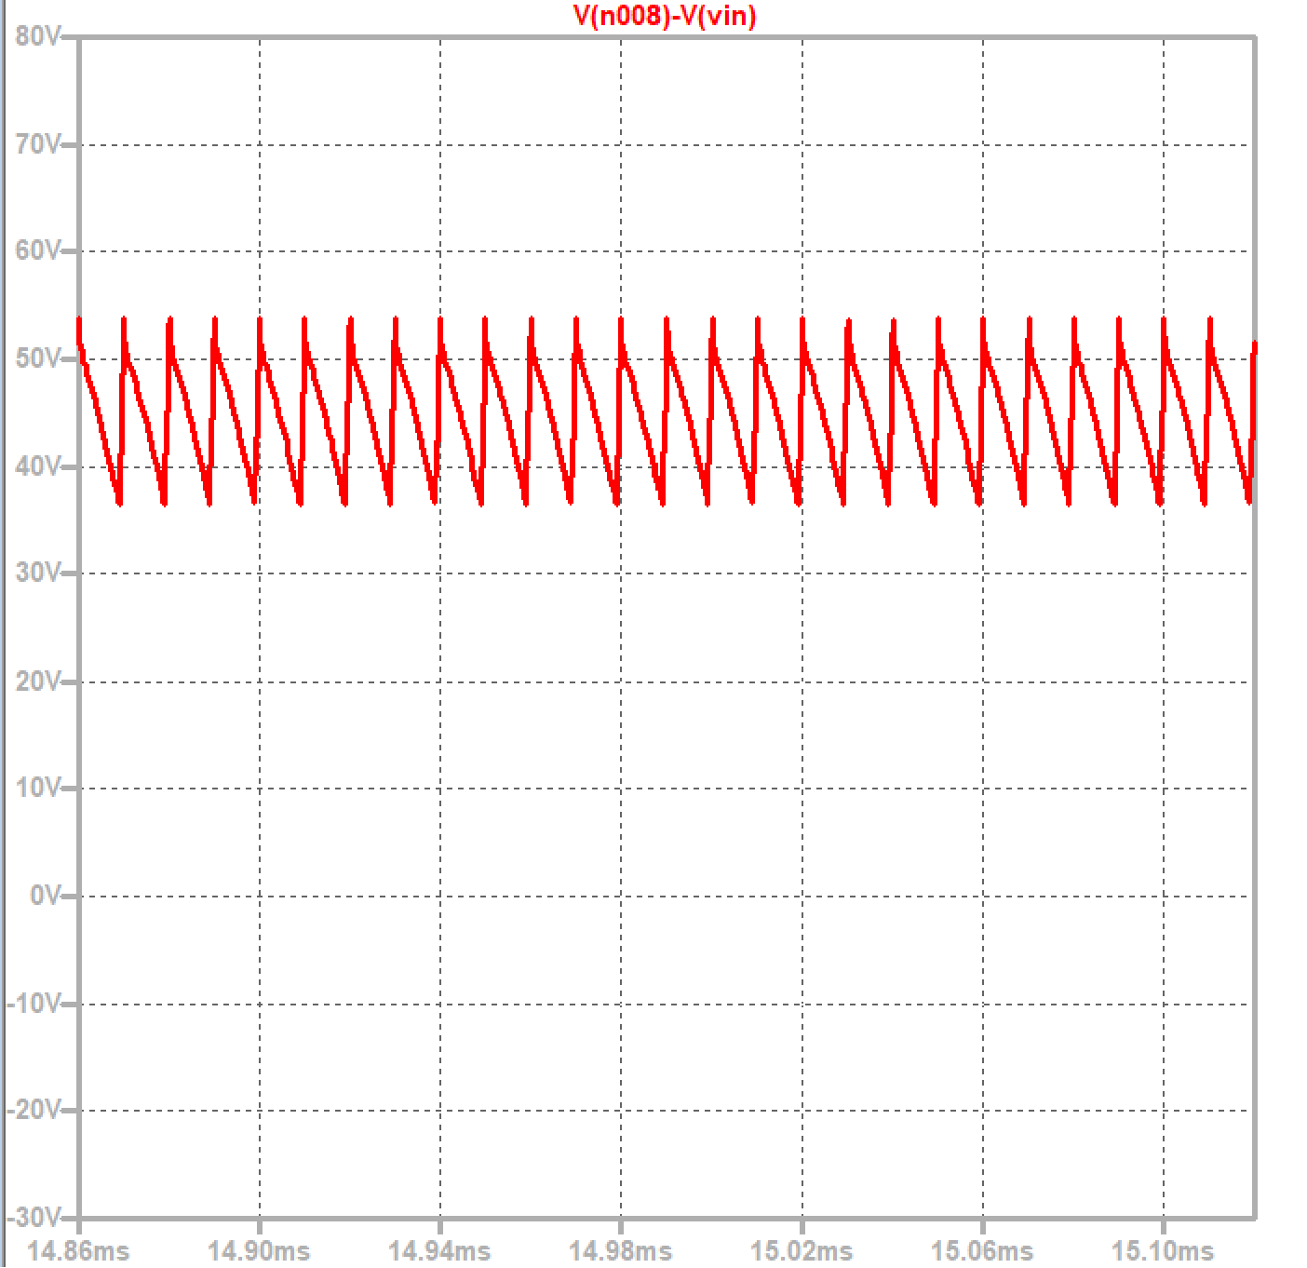
Voltage on capacitors
Vertical capacitors:

Slide 35
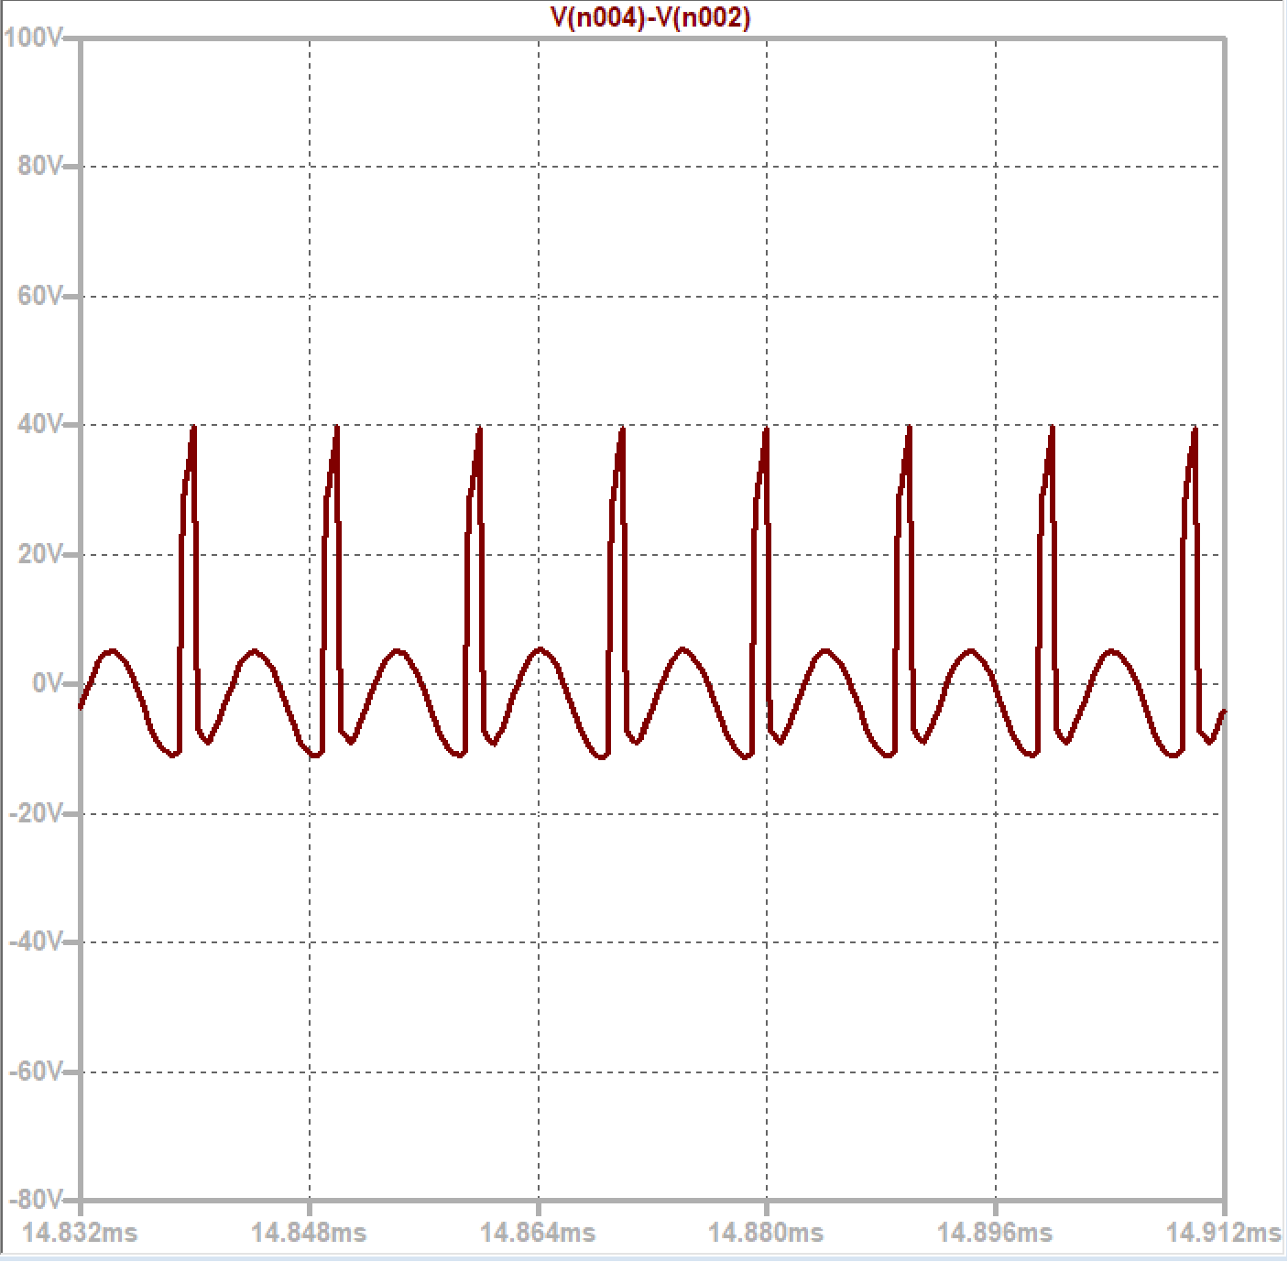
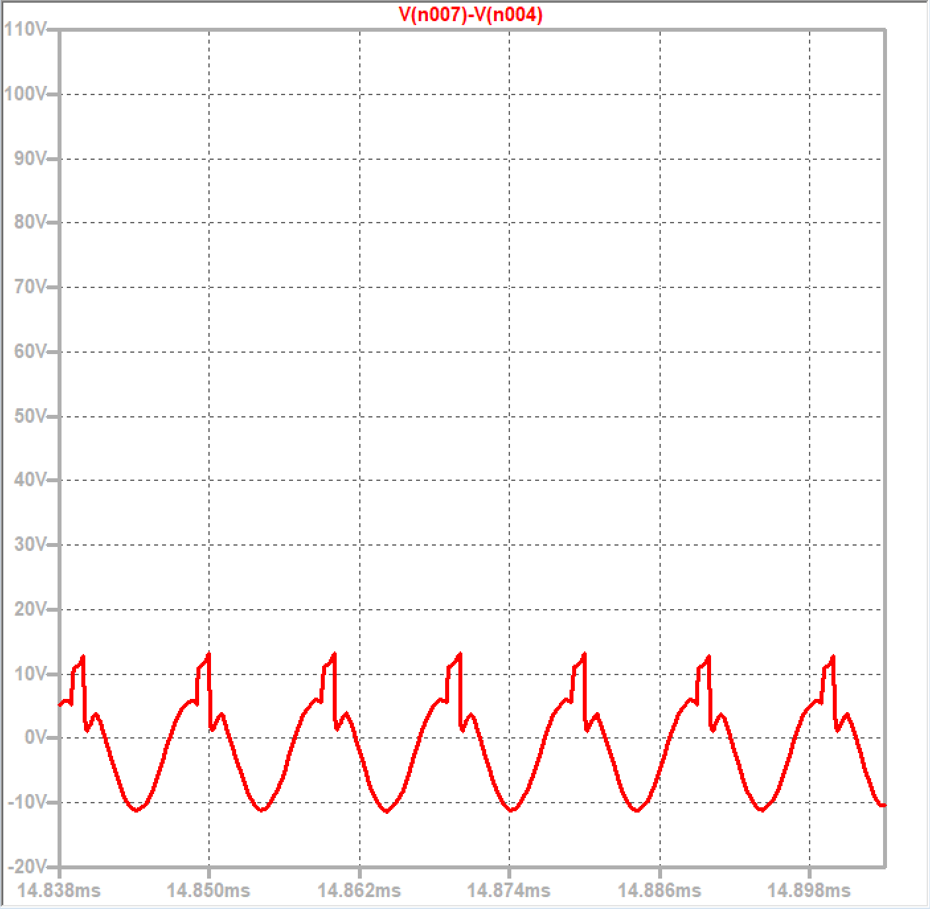
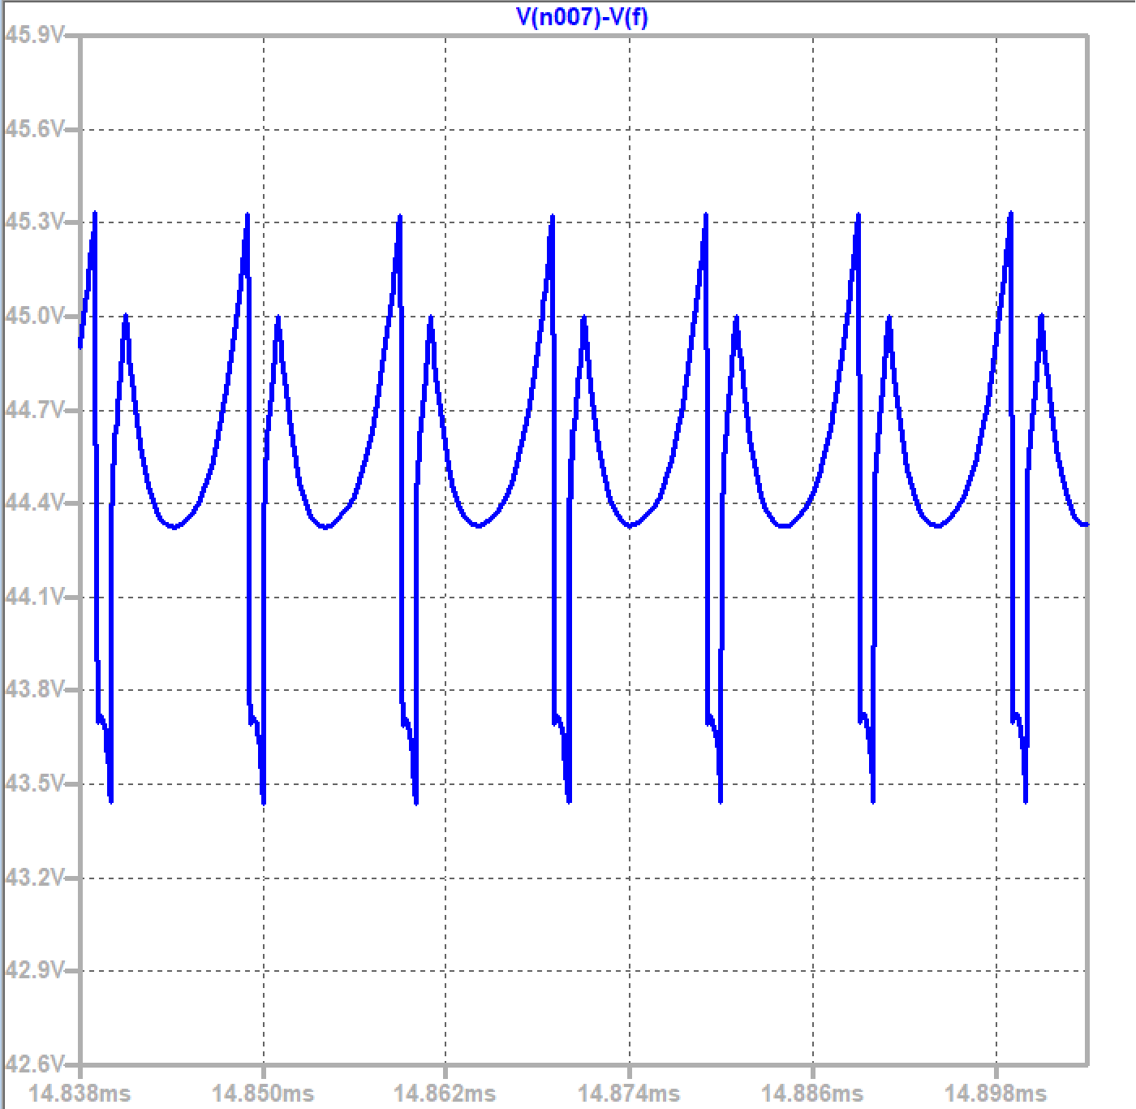
Voltage on capacitors
Voltage on stuck capacitors

Slide 36
Problems we can see from the simulation: overshoot
overshoots: we can see from the output voltage simulation that we have an overshoot with approximately 10v and this can damage the converter, and can malfunction the load in sensitive cases.

Slide 37
How to solve the problem?
1. Ramp Control:
Applying ramp control to PWM for smoother duty cycle changes, reduces overshoot
2. Parameter Adjustment:
Optimize controller and converter parameters for ideal balance between response time and overshoot
3. Simulation Analysis:
Iterate design using simulations to refine parameters and control strategies for minimizing overshoot

Slide 38
Problems we see from the simulation: spikes
having spikes in the current and voltage on the components can cause some serious problems that affect the results.
01
Voltage Stress: Excessive spikes can subject the capacitor to elevated voltage stress, potentially exceeding its rated voltage. This may compromise the capacitor's integrity and lead to premature failure.
02
Component Overheating: Rapid voltage spikes can result in increased power dissipation within the capacitor and surrounding components, leading to overheating and reduced reliability.

Slide 39
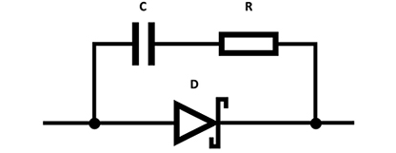
How to solve the problem?
Snubber Network: Introduce a snubber network, consisting of a resistor and capacitor in parallel, to suppress high-frequency voltage spikes. The snubber network absorbs excess energy and reduces the amplitude of voltage transients.

Slide 40
Problems we can see from the simulation: voltage output & solutions
so to solve the problem we had to:
change Duty Cycle Calculation:
Verifying the duty cycle calculation in our control is appropriately calculated to achieve the desired output voltage.
Inductor and Capacitor Values:
Confirm that the inductor and capacitor values in the boost converter circuit align with the intended design.

Slide 41
Changes we made in the circuit
we changed the duty cycle to 9/10 to make the result better.
Change the values of the components that lead us to the appropriate output voltage.
add a gate driver to the circuit, which enhance switching speed and reduces losses
we chose to use GaN transistors.

Slide 42
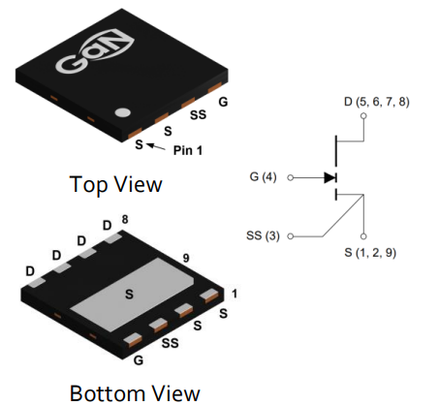
Why GaN transistors?
GaN transistors offer:
faster switching, lower resistance, and higher power density compared to traditional silicon transistors.
They result in more efficient and compact power systems with reduced heat dissipation and are well-suited for high-frequency applications, making them ideal for various power electronics applications.

Slide 43
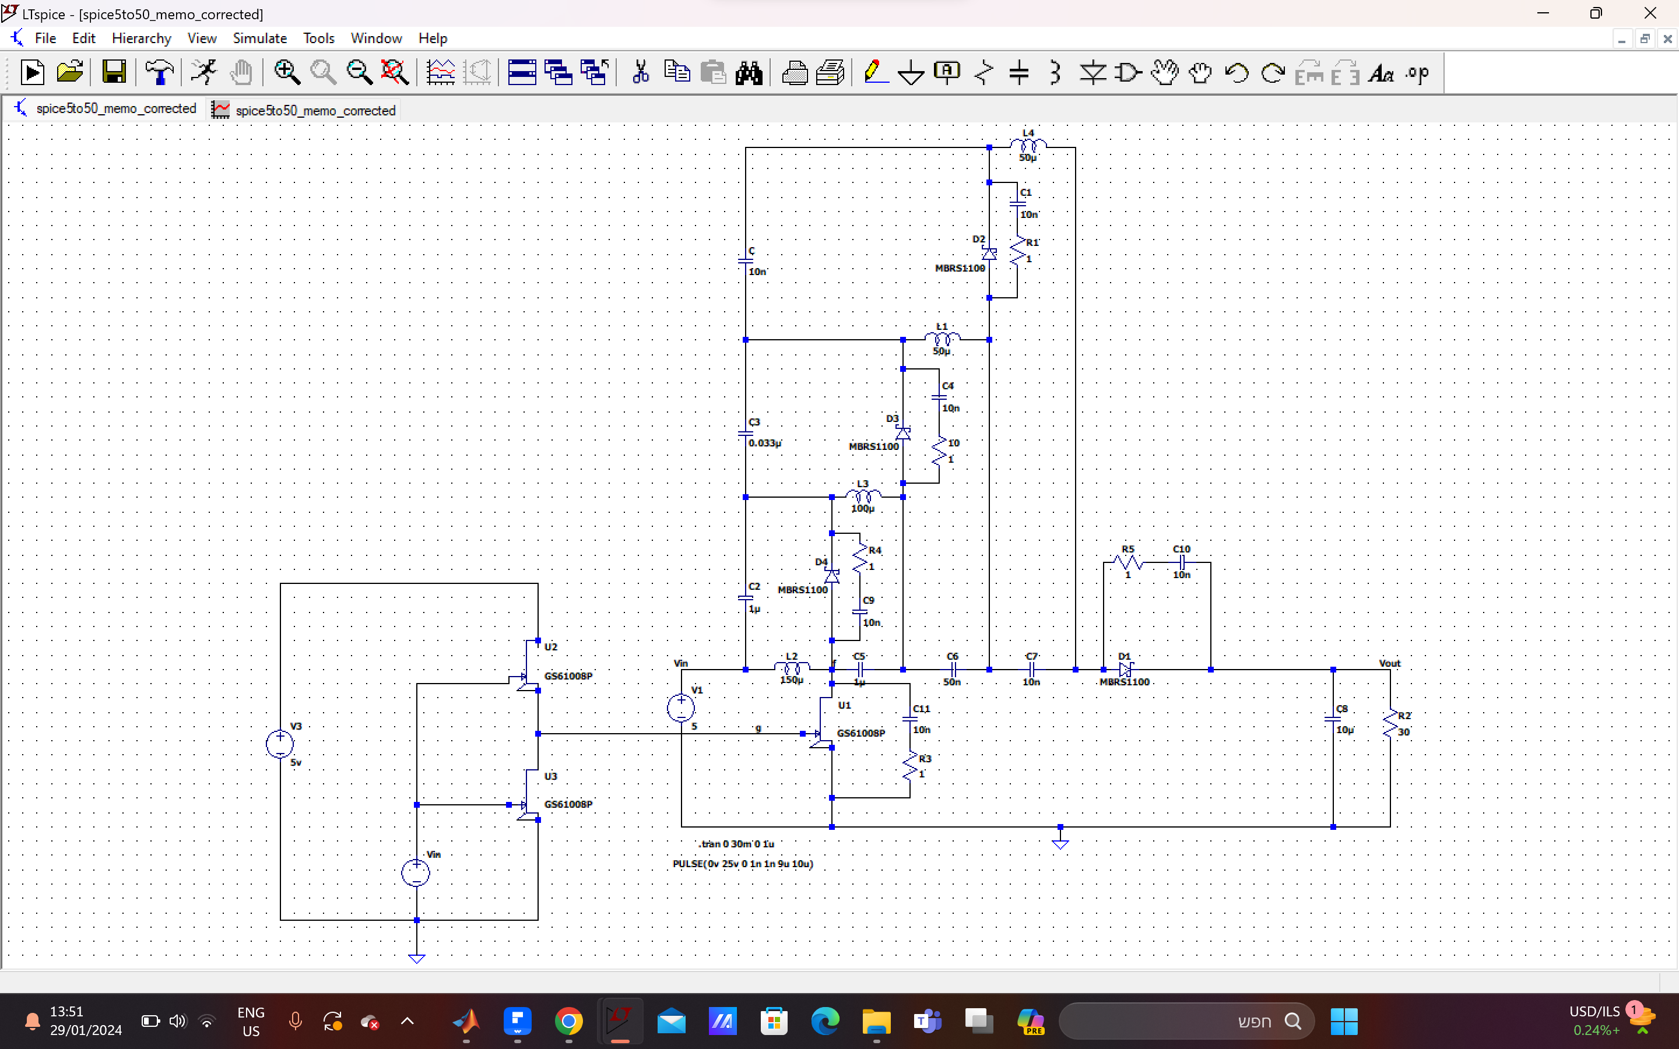
Modified boost converter circuit

Slide 44
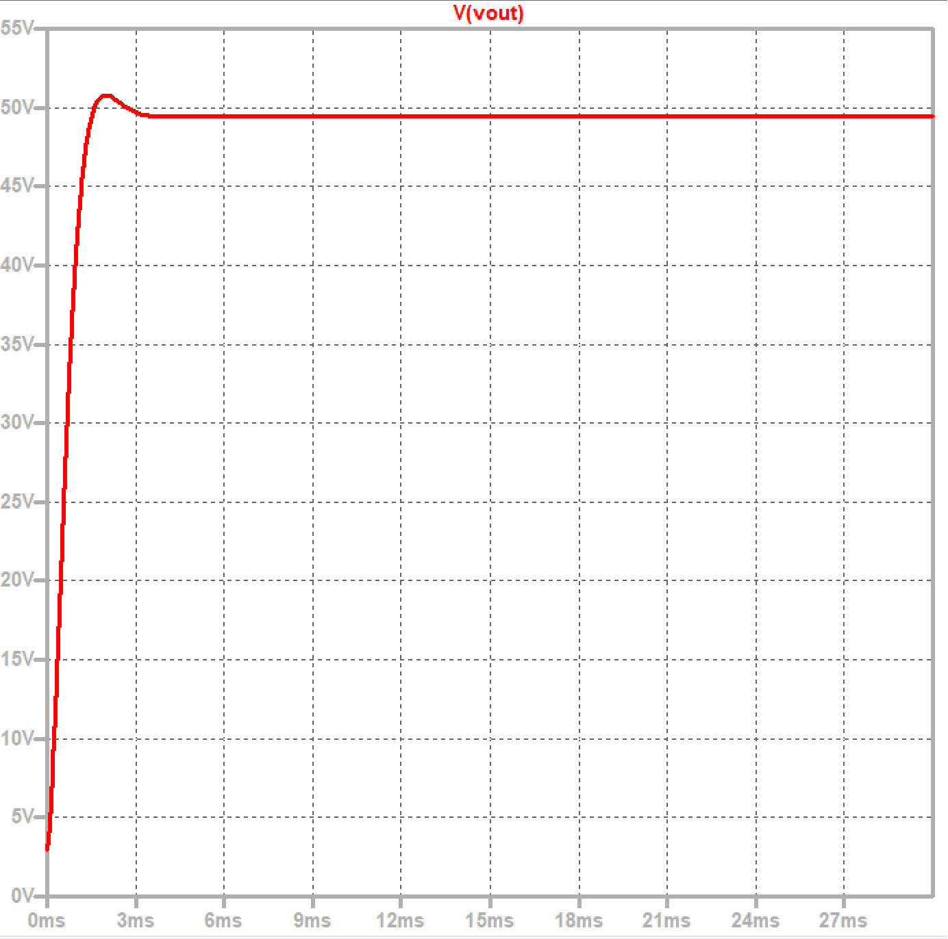
Modified circuit output voltage simulation

Slide 45
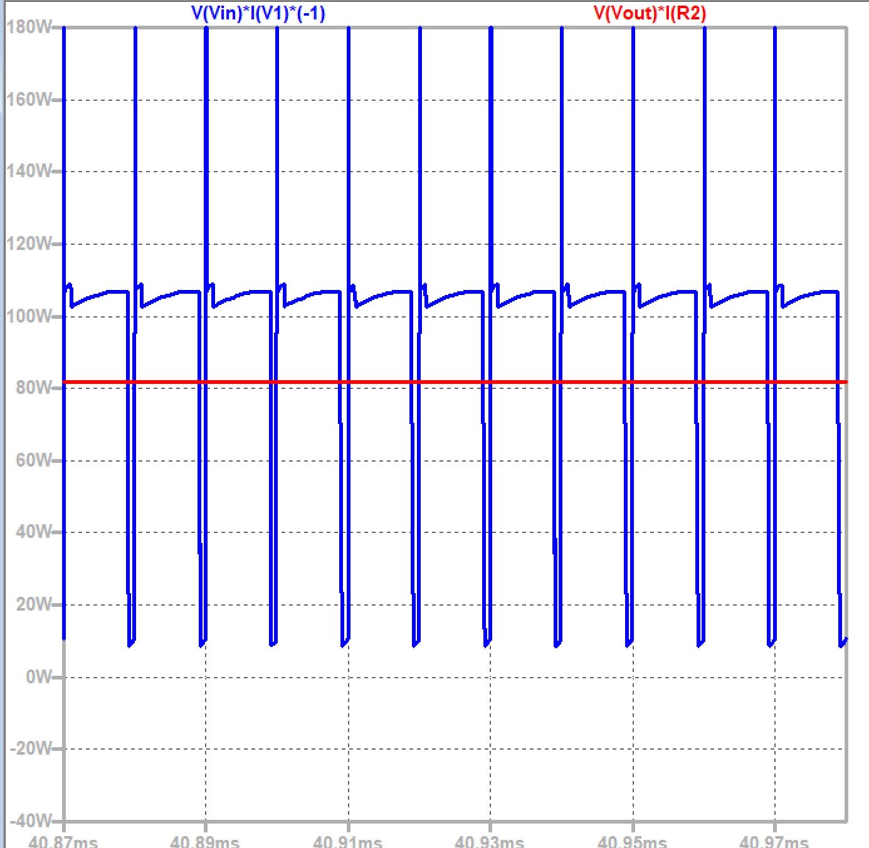
Modified circuit: efficiency 85%

Slide 46
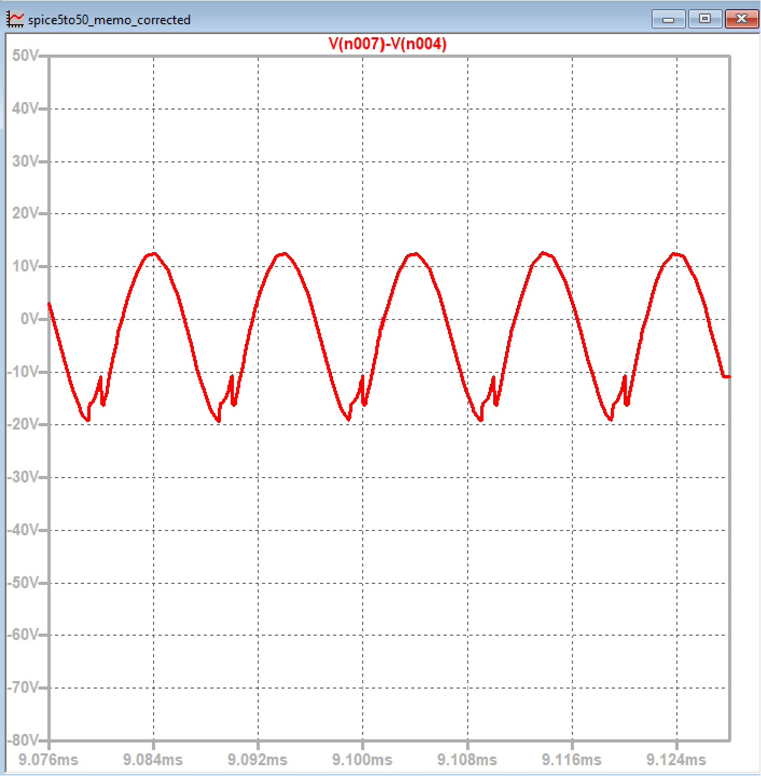
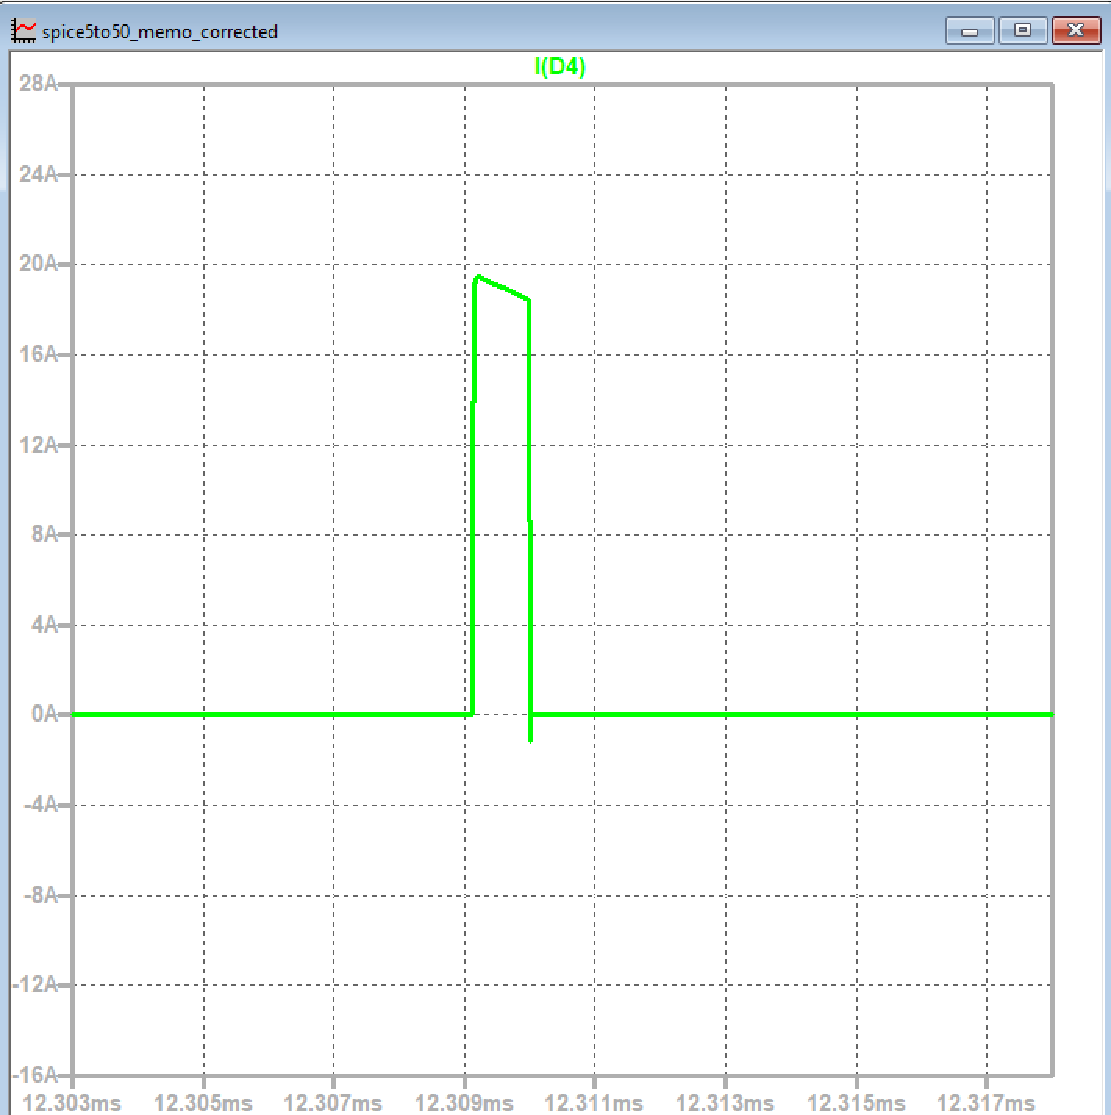
Solving problems: spikes

Slide 47
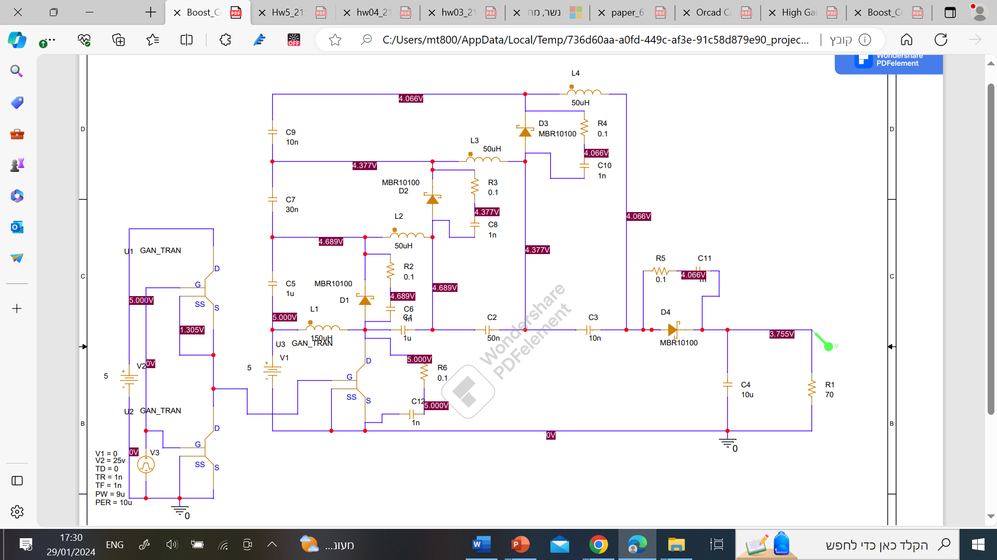
Orcad capture full schematic

Slide 48
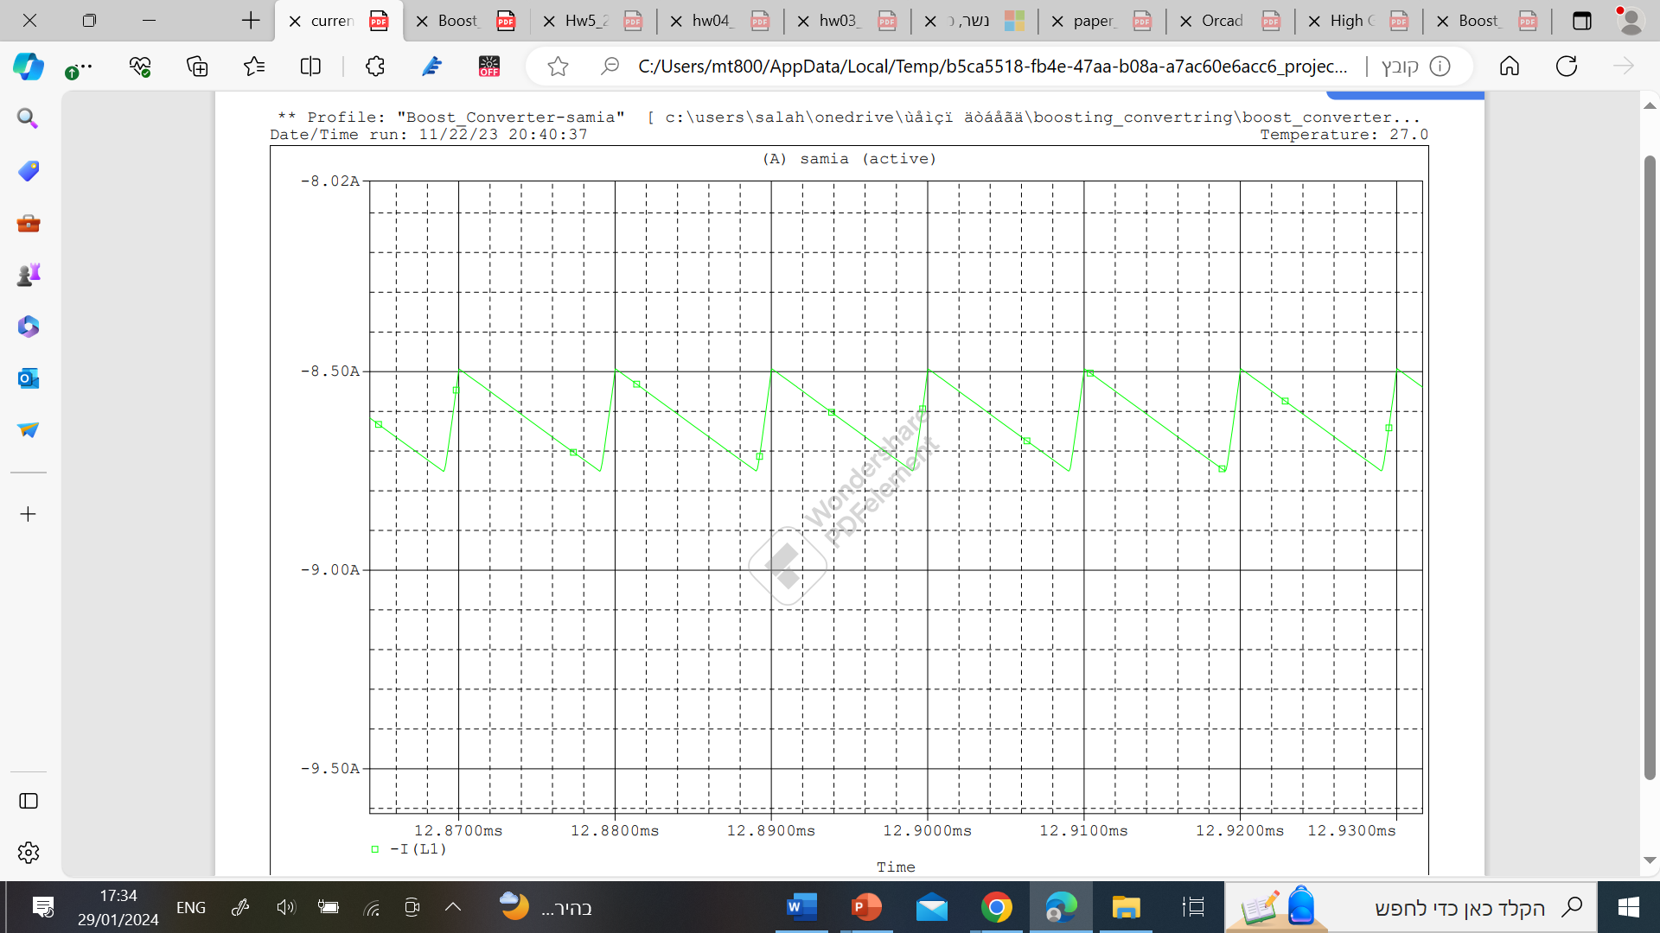
Orcad simulation: current during first inductor

Slide 49
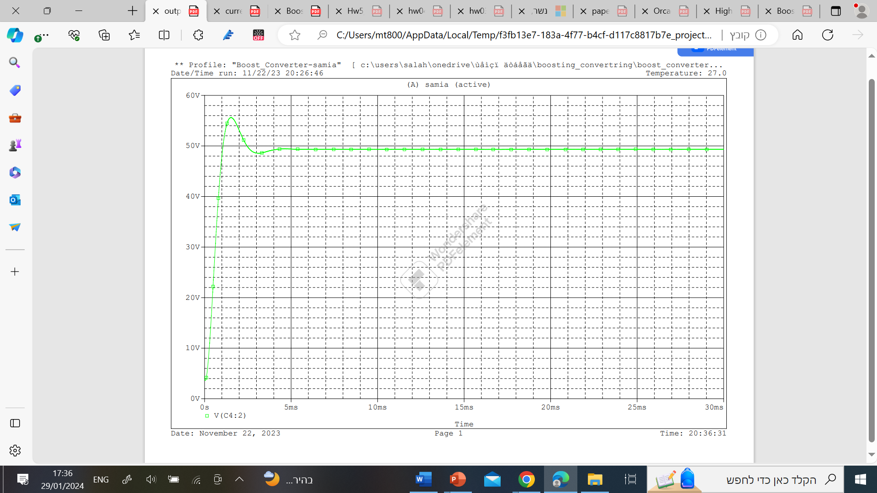
Orcad capture: output voltage simulation

Slide 50
BOM- bill of materials
PCB Footprint | Part NUMBER | Quantity | Reference | Item
CAPC3216X180N | CL31B105KCHNNNE | 2 | C1,C4 | 1
CAPC1608X95N | 0603B333K500CT | 1 | C2 | 2
125LS50R | 125LS50-R | 1 | C5 | 3
CAPC1608X87N | C0603C103K2RAC7867 | 2 | C3,C6 | 4
CAPC3225X280N | CL32Y106KCVZNWE | 1 | C7 | 5
CAPC1005X55N | GRM155R71C102KA01D | 5 | C8,C9,C10,C11,C12 | 6
to220ac | MBR10100 | 4 | D1,D2,D3,D4 | 7
SRR4028151Y | SRR4028-151Y | 1 | L5 | 8
SRR1205500YL | SRR1205-500YL | 3 | L6,L7,L8 | 9
GS61008P | GS61008P | 1 | Q1 | 10
GS61008P | GS61008P | 2 | Q2,Q3 | 11
INDAD4800W83L1800D750 | AC05000001008JAC00 | 1 | R1 | 12
TO508P344X1041X2058-2P | MP850-50.0-1% | 5 | R2,R3,R4,R5,R6 | 13

Slide 51
Challenges faced
1. High-Frequency Switching
High switching frequencies posed challenges, requiring careful consideration of component characteristics and potential EMI issues
2. Component Stress
Distributed architecture introduced complexities in managing component stress, demanding meticulous care to ensure longevity and prevent failures

Slide 52
Solutions Implemented
1. High-Frequency Switching
To tackle high-frequency switching challenges, simulations optimized component values. Results guided the choice of GaN transistors and Schottky diodes for compatibility with the desired frequency
2. Component Stress
Conducted stress analysis to identify inductor and capacitor stress points. Solution: Careful selection of robust components and thermal simulations to maintain acceptable temperature variations

Slide 53
Lessons Learned
The challenges encountered throughout the project provided valuable insights into the intricacies of designing and implementing an extended boost converter. Key lessons learned include the importance of a holistic approach to component selection, the significance of thorough simulations in predicting real-world behavior, and the iterative nature of control system tuning for dynamic power electronics systems.

Slide 54
Conclusions-Key Findings and Contributions
The culmination of this extended boost converter project has yielded noteworthy findings and contributions to the field of power electronics. The key outcomes can be summarized as follows:
1. Voltage Gain Enhancement
Extended boost converter achieved substantial voltage gain improvement, utilizing cascaded quadratic-type boost converters for targeted performance, ideal for high-output applications
2. Reduction in Ripple Voltage
Distributed output voltage across stages mitigated ripple, improving power quality and enhancing overall system stability and reliability

Slide 55
Conclusions-Relevance and Significance
1. Applicability in Renewable Energy Systems
Project outcomes are crucial for renewable energy, especially fuel cells. Extended boost converter's high voltage gains without a central capacitor make it attractive for renewable energy applications
2. Advancements in Power Electronics
Project contributes to power electronics advancements. Extended boost converter's distributed architecture addresses challenges, ensuring more efficient and reliable power conversion systems

Slide 56
Conclusions-Areas for Future Research
1. Integration with Energy Storage Systems
Future research: Explore integrating the extended boost converter with energy storage systems for enhanced energy management and grid integration
2. Optimization for Specific Applications
Future exploration: Tailor the extended boost converter for specific applications like electric vehicles or off-grid power systems, enhancing versatility through optimization for varying load profiles
3. Further Control System Enhancements
Future research: Enhance extended boost converter control with advanced strategies. Explore predictive and adaptive controls for improved precision and efficiency.

Slide 57
Final Reflection
In conclusion, the extended boost converter project has not only achieved its primary objectives but has also laid the groundwork for continued innovation in power electronics. The combination of enhanced voltage gain, reduced ripple, and effective control strategies positions the extended boost converter as a promising solution for a wide range of applications in the evolving landscape of renewable energy and power systems.

Slide 58
THANK YOU
Q&A

